Slide 1
2-2 Malicious Code Part 2

Slide 2
RANSOMWARE
Definition: program that blocks access to files or block use of the device until a ransom is paid
Methods used are:
  Encrypt files - threaten to delete
  Lock the screen so no other programs will show
  Lock the PC Master Boot Record so device won’t boot
  Harvest browser activity and threaten to post online
Notes:
Ransomware has exploded onto the malware scene in the last few years. Besides locking your data, most of the ransomware uses some fear tactic to push the victim to react quickly and pay the ransom. Health care providers especially are getting very hard hit because they are now required to keep patient health data in digital form and once the files are locked, they are very motivated to give up and pay the ransom to get a timely return to accessing the data.
We will look at how to protect against malware in general in another lesson. However, it is worth saying now that the BEST protection against ransomware is to do regular backups of your files to an external drive that is disconnected from the PC after backup. Ransomware knows how to infect attached devices and network shared drives and even files stored in the cloud!!

Slide 3
SPYWARE
Definition: software that gathers data and forwards it to a third party without the consent or knowledge of the user
Example: keylogger
Info can include passwords, PINS, credit card numbers, browsing habits, harvesting email addresses
Spyware programs often have undesirable effects like slowing down PC by using processor and memory
Does not spread to other computers like a virus or worm.
Notes:
Spyware runs on the computer, tracking your activity and reports it to others, such as advertisers or hackers. Sometimes spyware is a program that was purchased by the computer owner (might be your boss or spouse or a parent!) in order to monitor the use of the computer.
Alternatively, it is often installed through a Trojan or a clickable link like a pop-up message that may prompts you to download a software utility that you “need”, or software may be downloaded automatically without your knowledge. Could be something as evil as a keylogger or it might be more innocent tracking of what items you are buying so they can provide more targeted ads.

Slide 4
ADWARE
Definition: Software that installs advertisements on the PC in the form of toolbars or popups or banners
It usually is installed alongside a shareware or freeware application
Displays web-based ads through pop-up windows or through advertising banners
Often closing one pop-up opens another, making it impossible to use the browser
Notes:
Adware is irritating and can even incapacitate your use of the computer or at least the browser because of all the pop ups and redirects. Companies will pay for “eyeballs” - the fact that someone looked at their advertisement. A good example of adware are the toolbars that are added to your browser - sometimes installed when you update a program like Java or Adobe.

Slide 5
PUP or PUA
Potentially Unwanted Program or Application
Definition: unwanted programs on the PC and often come bundled with freeware programs. They are not malicious BUT they can have some unwanted effects on the device.
  Displays popups
  Installs a toolbar or browser extension
  Changes the homepage of the browser
  Changes the default search engine
  Slows down PC performance
Notes:
The PUP/PUA and Adware programs are not really malware because there is no malicious activity - no damage is done and nothing is stolen like with spam, spyware or trojans. BUT they can have a very bad effect on the performance of your pc by “clogging” it up with inefficient code and hogging memory / processor resources. The words “potentially unwanted” are used in the name because it is real software that could be something a user wants, but not likely.
This is the best example of where the user clicked “OK” or said “yes” to a message without really reading it.

Slide 6
SPAM
Definition: unsolicited commercial email, the electronic equivalent of the junk mail that comes through your mailbox (not illegal)
The most common types of spam concern
  Prescription drugs
  Herbal remedies, or weight loss drugs
  Get-rich-quick schemes (“Nigerian banker”)
  Financial services
  Offers or schemes for reducing debts
Notes:
The key is that the mail is unsolicited. Often when we are on a website, especially shopping, we don’t notice that there is a checkbox to sign up for the newsletter or discounts. That means we got on their mailing list and the subsequent emails are technically not spam - we signed up for that by not paying attention. Those are usually easy to unsubscribe from, but real spam isn’t so easy.

Slide 7
How Malware Affects Your PC
Degrades performance
  Competes for use of processor and memory resources
Causes system instability
  May make system freeze or crash
Damages files
  May delete or corrupt important data or system files
Releases confidential information
  Theft of personal data including passwords & identity
Notes:
To wrap up this section, let’s examine how malware can affect your actual computer. These are fairly obvious and have happened to most of us at one time or another.

Slide 8
How malware can affect you
Lose ability to use Internet or your PC
  Your browser becomes unusable
  ISP blocks you from access
  Can lose access to all files or even use of PC
Blamed for spamming
  Your email address may be used for mass email
Be accused of crimes
  Publishing illegal content
  Filesharing media theft
Notes:
But many people don’t realize that having malware on your PC can result in personal consequences.
You might be unable to use the Internet if the malware affects performance BUT you could also be blocked by your ISP (Internet Service Provider) if they see a lot of activity that indicates you are infected. Most ISPs actually give away anti-virus software to their clients because they feel some responsibility to keep a clean network. So if your computer seems to be participating in botnet activity or sending out lots of weird traffic, they will block you to protect the rest of their client.
Also consider that malware or a broken OS could mean you have lost all your files - they could be inaccessible or they could actually be deleted or damaged.
If your computer has been accessed by a spammer, they may use your email address - in which case your address could end up on a blacklist. This means that any emails you send out get dropped instead of being delivered.
It is against the law to have certain types of files on your computer, so many criminals will store the illegal files on someone else’s computer and then access the files remotely. That person’s computer could be yours and you would never know it until the law comes knocking!
certain types of pornography, especially pictures of children (pedophilia) - these are illegal and there are severe penalties.
downloading software, movies or music - even though people call it “filesharing”, getting digital materials from downloads like bittorrent is actually stealing and if there is a lot of it on your computer, there are financial / jail time penalties.

Slide 9
Stop It
Use caution in executing programs or opening documents
“If you don’t know where it came from, don’t open or run it.”
Keep system files updated – install patches
Use antivirus software – UPDATED!
Consider policies to block macros or to scan email attachments
Notes:
The methods to mitigate against malware infection may seem too simple - these are rules they have been hearing for a long time, way before this cybersecurity class. But that is because these are the basic best practices for avoiding infection.

Slide 10
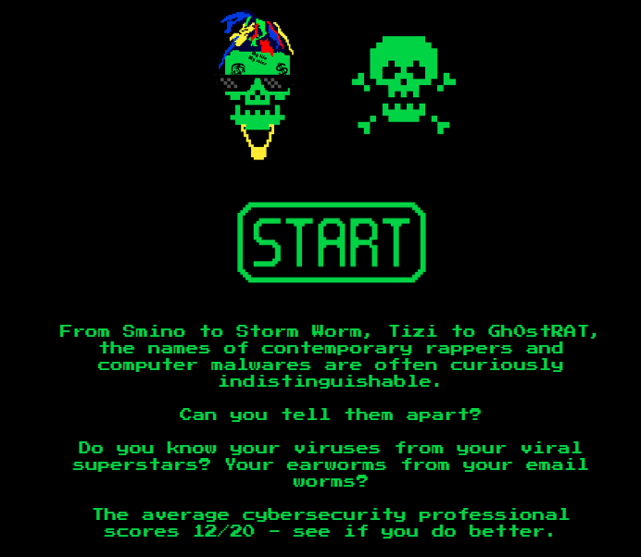
Activity – Rapper or Malware Game
Notes:
This activity is used as closure for this unit on the types of malware. It is fun to play as a class or students can access the site independently and then compare scores. It looks like a silly game, but they include serious information about the malware, including some of the ones in Historic Malware Research.
https://promon.involve.me/rapper-or-malware

