Slide 1
Microsoft Teams 365
Module 3: Building an Effective Teams Environment
© 2025 Cengage Learning. All Rights Reserved. May not be copied, scanned, or duplicated, in whole or in part, except for use as permitted in a license distributed with a certain product or service or otherwise on a password-protected website for classroom use.

Slide 2
Building an Effective Teams Environment
As the meeting host, you can organize a meeting with engagement and teamwork by:
  Adjusting meeting options
  Sharing your agenda as meeting notes
  Setting up whiteboards for collaboration
  Creating breakout rooms to foster brainstorming new ideas

Slide 3
Meeting Options
Feature | Features of Microsoft Teams
Who can bypass the lobby? | The host can use this option to decide who is admitted into a meeting immediately, depending on whether they are a member of the organization or a guest, and who should wait in the lobby for someone to admit them.
Announce when callers join or leave | This slider can be set to make a sound notification each time someone enters or leaves the meeting.
Who can present? | The organizer can identify who is allowed to share their screen.
Allow mic or camera for attendees | The host can mute the microphone or turn off the camera of anyone who is not presenting. Participants can raise their hand to request to speak and the host can unmute them.
Notes:
When you host a meeting, you will want to change settings so that your discussion is more secure and easier to facilitate, especially if the meeting involves a larger group.

Slide 4
Meeting Options
Feature | Features of Microsoft Teams
Record automatically | Save the meeting automatically as soon as it begins or turn on the option to record.
Allow meeting chat | The host can allow or block the chat if, for example, they do not want to allow questions in order to stay on topic.
Allow reactions | The meeting organizer can use this option to determine whether people can use reactions (emojis) during a meeting.
Allow CART Captions | The host can toggle on CART captioning for a meeting. CART stands for Communication Access Realtime Translation, which refers to the method captioning professionals use to transcribe live audio into text that is displayed for the benefit of deaf, hard-of-hearing, or non-native-speaking audiences. CART captions are shared with a link.

Slide 5
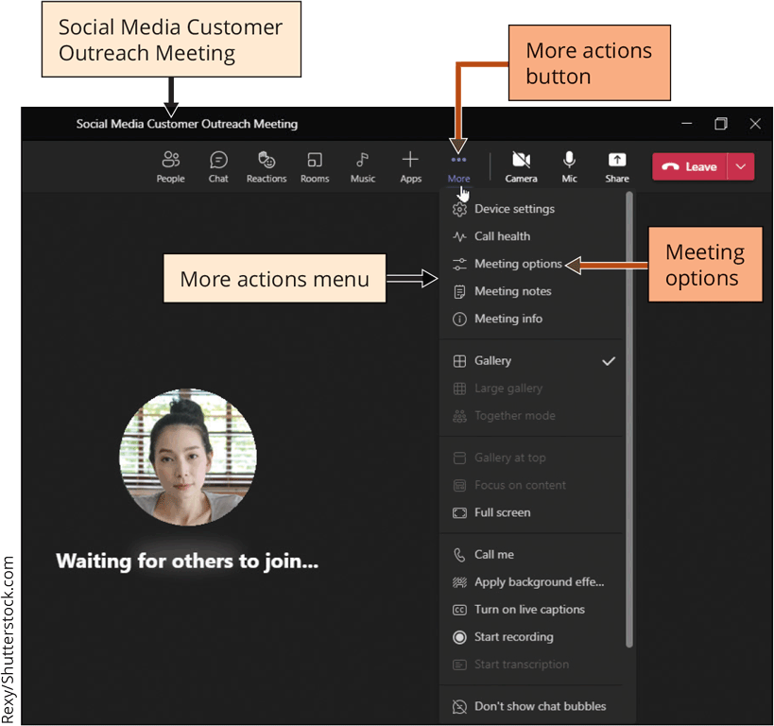
Fostering Teamwork within
Microsoft Teams
To Customize the Meeting Options (1 of 2)
  Open the desktop version of Microsoft Teams
  Click the Calendar button on the Apps bar
  Navigate to desired meeting, click the meeting invitation, and then click the Join button
  Click the Video slider to turn off your video camera
  Click the Join now button to begin the meeting
  Click the More actions button
  Click Meeting options

Slide 6
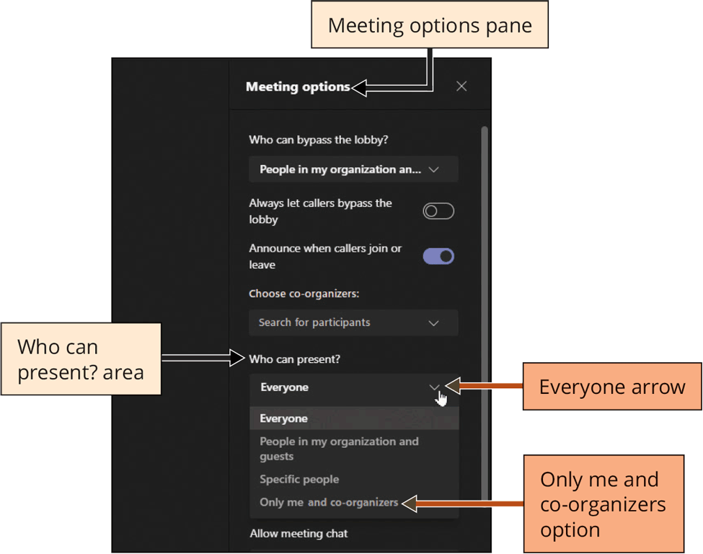
Fostering Teamwork within
Microsoft Teams
  To Customize the Meeting Options (2 of 2)
  Click the Everyone arrow in the Who can present? area of the Meeting options pane to set the roles of people participating in the Teams meeting
  Click Only me and co-organizers option and designate all other meeting participants as attendees
  Slide the ‘Record automatically’ slider to the right to record the meeting automatically for future viewing
  Click the ‘Close right pane’ button in the Meeting options pane to close and update the meeting options for this meeting

Slide 7
Taking Notes and Sharing Files in a Meeting
The Cornell system of notetaking outlines the five Rs of notetaking:
  Record: Jot down key concepts and facts.
  Reduce: After the meeting, sum up the recording information into keywords and questions.
  Recite: Repeat or rewrite what was recorded in your own words.
  Reflect: Consider how you will work with this information and what your thoughts are.
  Review: Review notes that same day and revisit them periodically for long-term retention.

Slide 8
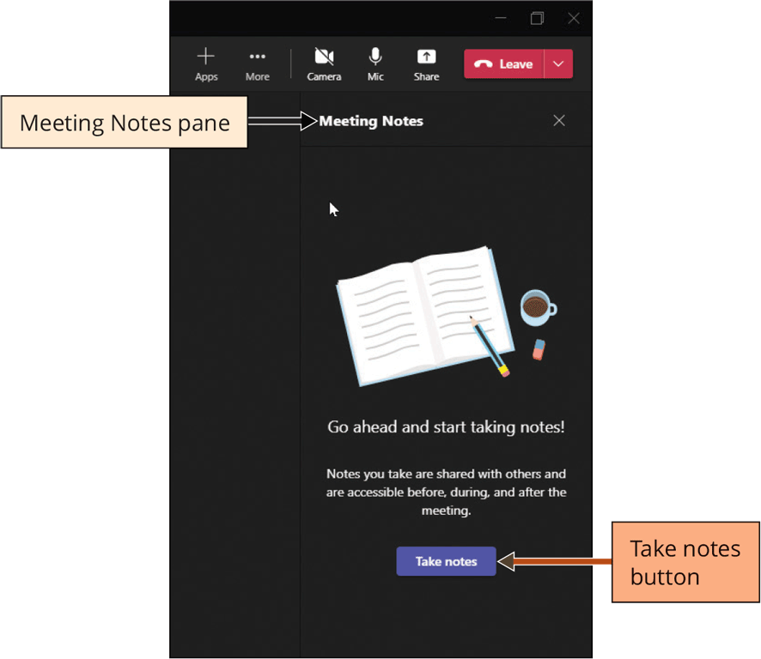
Taking Notes and Sharing Files in a Meeting
To Take Notes during a Meeting
  Within the meeting, click the More actions button
  Click Meeting notes on the More actions menu
  Click the Take notes button in the Meeting Notes pane
  Click below the Notes heading and type the desired notes in the notes area
  Click the Join button to close the Meeting Notes tab

Slide 9
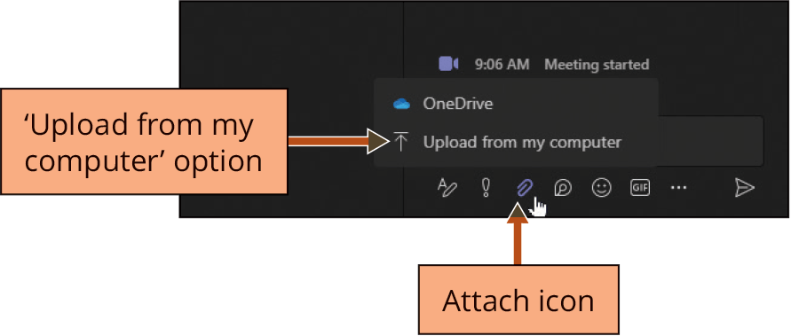
Taking Notes and Sharing Files in a Meeting
To Share a File in Chat during a Meeting
  Within the meeting, click the Chat button to display the Meeting chat pane
  Click the Attach icon
  Click the desired upload option to display the Open dialog box and select a file
  Click the Open button
  Click the Send button
  Click the Close right pane button to close the meeting

Slide 10
Collaborating on Microsoft Whiteboard
Microsoft Teams includes an interactive whiteboard that provides:
  A blank page for notes
  Templates for meetings
  Drawings
  Images that your colleagues can work on together

Slide 11
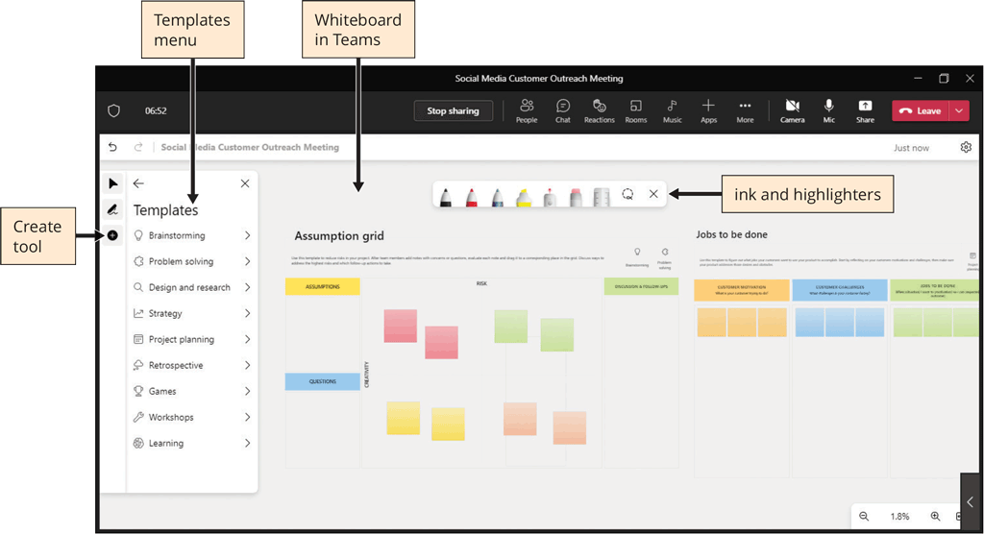
Collaborating on Microsoft Whiteboard
Digital whiteboards can start with a blank canvas for brainstorming or a structured template that allows for workplace scenarios such as jobs to complete or an assumption grid

Slide 12
Collaborating on Microsoft Whiteboard
Whiteboard users have access to tools including:
  Inking
  Sticky notes with multiple colors
  Text tool for typing
  Shapes tool for adding shapes and lines
  Reactions

Slide 13
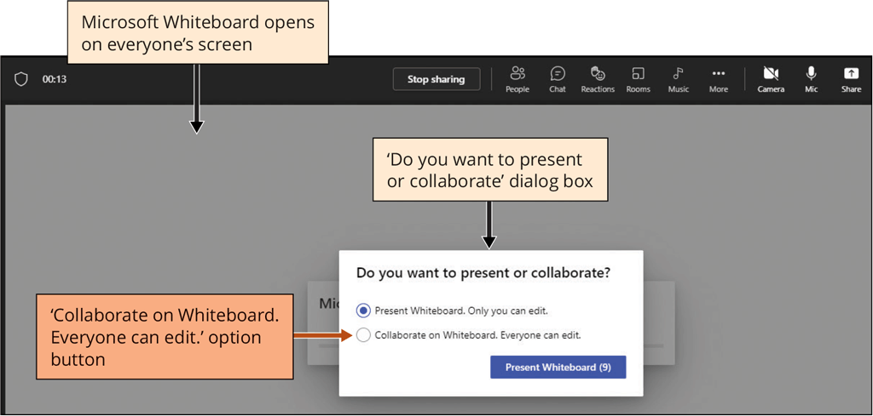
Collaborating on Microsoft Whiteboard
To Collaborate Using the Microsoft Whiteboard (1 of 2)
  Click the Share button in the meeting
  Click Microsoft Whiteboard to open a blank whiteboard on the meeting stage on everyone’s screen
  Click the ‘Collaborate on Whiteboard. Everyone can edit.’ option button to share control of the whiteboard

Slide 14
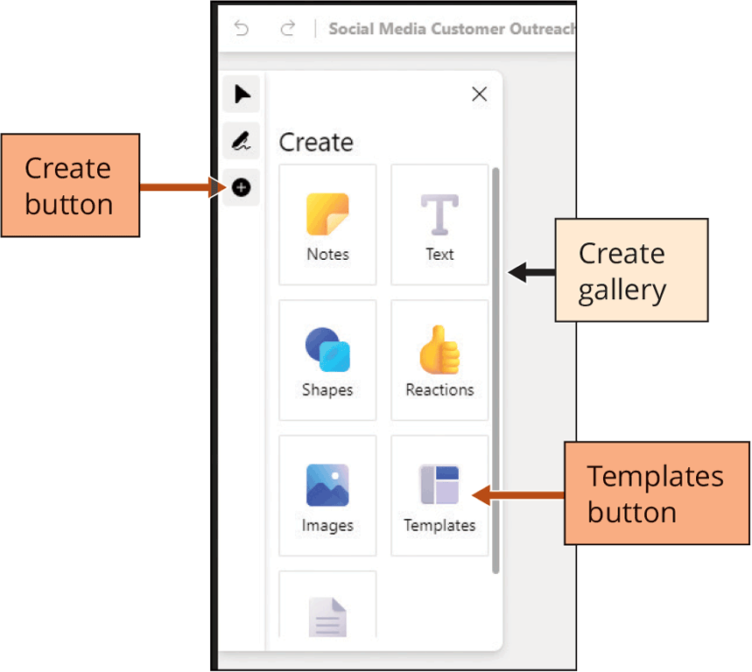
Collaborating on Microsoft Whiteboard
To Collaborate Using the Microsoft Whiteboard (2 of 2)
  Click the Create button in the Whiteboard tools to display the Create gallery
  Click the Templates button to display the Templates menu
  Click the desired gallery arrow to view the templates
  Click the desired template

Slide 15
Managing Breakout Room
Everyone can voice their opinions and contribute their ideas in smaller groups
Can split your main meeting into smaller group discussions
Breakout rooms can be set up before the meeting or once the meeting begins
Can assign people to each breakout room automatically or manually

Slide 16
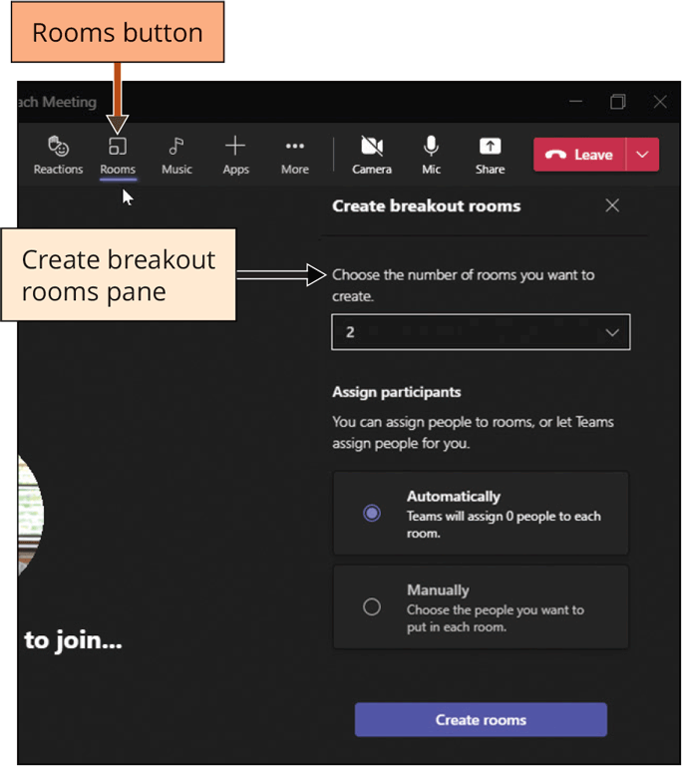
Managing Breakout Rooms
To Create and Name Breakout Rooms
  Click the Rooms button in the meeting
  Click the ‘Choose the number of rooms you want to create.’ arrow to display a list of numbers for breakout rooms
  If necessary, select Automatically to automatically assign participants randomly to the breakout rooms
  Click the Create rooms button

Slide 17
Managing Breakout Rooms
To Create and Name Breakout Rooms
  Move the pointer over the Closed indicator for Room # to display the More options button
  Click the More options button for Room #
  Click Rename and type the desired name
  Click the Rename button

Slide 18
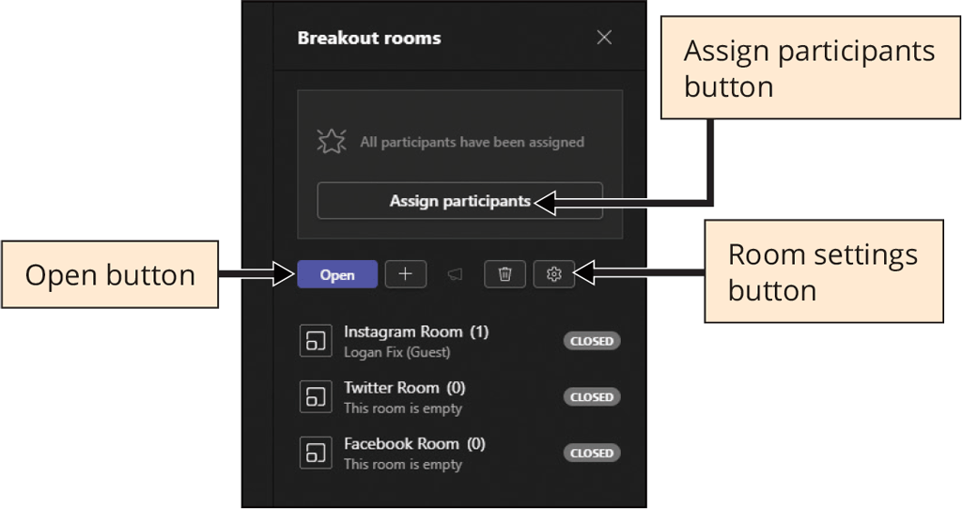
Managing Breakout Rooms
To Launch Breakout Rooms with an Audience (the Organizer)
  Click the Rooms button in a Teams meeting
  After participants arrive, click the Open button in the Breakout rooms pane
  Click the Assign participants button to place participants in rooms or let Teams place them randomly
  After the breakout room discussions are completed, click the Close room button to close the rooms and return the participants to the main meeting

Slide 19
Setting Your Status and Customizing
Your Settings
Status Options | Meaning
Available | No meetings or calls scheduled in the calendar in Teams
Busy | Teams automatically changes your status to busy when you are in a meeting or call
Do not disturb | When you want to present, select the Do not disturb status to stop pop-up notifications from interrupting your meeting
Be right back | When you are temporarily away
Appear away | When you need to focus on work and not respond immediately
Appear offline | When you want to appear that you are not signed into Teams, but you still receive notifications

Slide 20
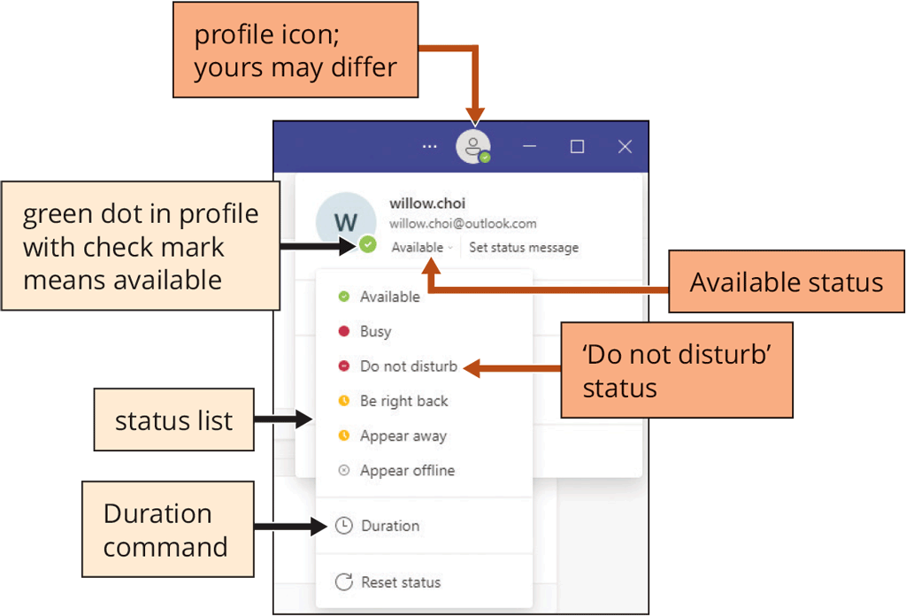
Setting Your Status and Customizing
Your Settings
To Set Your Status
  Click the Leave button to leave the meeting
  Click your profile icon at the top of Teams and click Available (your present status) to view the status list
  Click desired status in the status list to set your status and display a reminder message

Slide 21
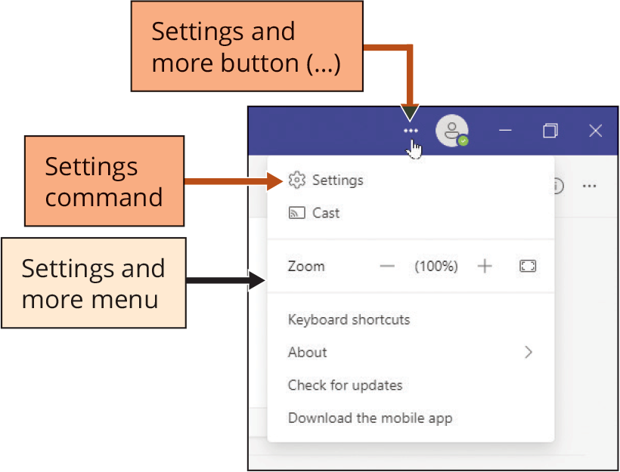
Setting Your Status and Customizing
Your Settings
To Customize Your Settings
  Click the Settings and more button (three dots) next to the profile icon to display the Settings and more menu
  Click Settings on the Settings and more menu to display the Settings dialog box
  Click High contrast in the Theme area (Settings dialog box)
  Click the Close button (Settings dialog box) to close the dialog box and display the Teams app in the High contrast theme

Slide 22
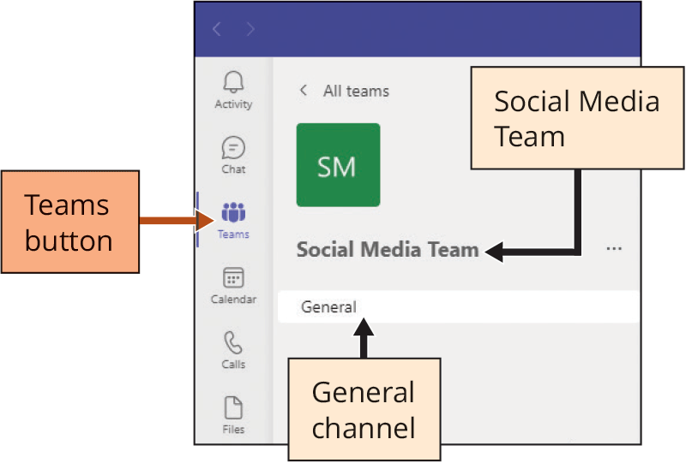
Setting Your Status and Customizing
Your Settings
To Create a Standard Channel
  Click Teams on the App bar
  Click the desired team name
  Click More options (three dots)
  Click Add channel and type desired name
  If necessary, select ‘Standard – Everyone on the team has access’ for the Privacy setting
Notes:
Channels can be created for any topic or project and help to target a single thread of conversation with the people who need to be a part of that particular discussion.

Slide 23
Setting Your Status and Customizing
Your Settings
To Create a Standard Channel
  Click the ‘Automatically show this channel in everyone’s channel list’ check box to make sure every team member has access to this new channel
  Click the Add button to add the new channel to the team

Slide 24
Knowledge Check Activity
When you need to focus on work and not respond immediately, you should set your status to __________.
Busy
Do not disturb
Appear away
Appear offline
Notes:
Instructions:
Pause to have students complete the question individually. Alternatively, pair students up to answer the question together. Allow extra time for students working in pairs.

Slide 25
Knowledge Check Activity: Answer
When you need to focus on work and not respond immediately, you should set your status to __________.
Answer: c
Appear away is for when you need to focus on work and not respond immediately.

Slide 26
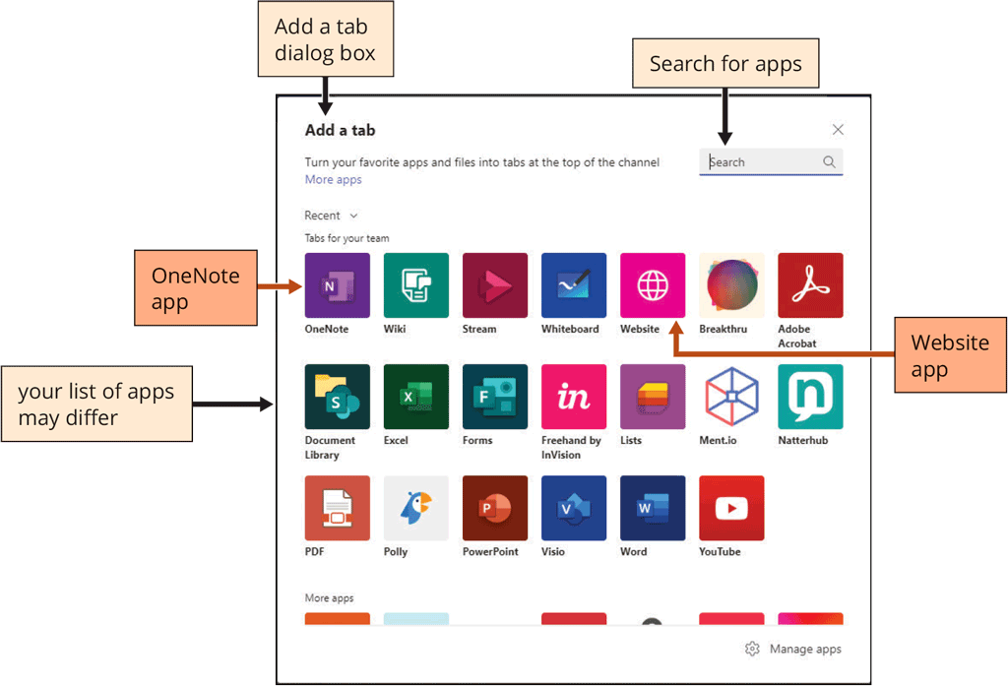
Extending Team Channels with Apps
To Add an App Tab to a Channel
  Click the desired channel
  Click the Add a tab button (plus sign)
  Click the desired app (Add a tab dialog box) to open the desired app dialog box
  Type a name or URL and then click Save
Notes:
Microsoft Teams can add apps within the Microsoft 365 suite such as Excel, PowerBi, and OneNote, but Teams can also add third-party apps made by other companies that work perfectly within Teams.

