Slide 1
Unit 1 Foundations & Threats
Section 1 - Intro to Security Concepts

Slide 2
Model of Computer Security
Protection = Prevention + (Detection + Response)
  Protection – What the goal is.
  Prevention – What you can do ahead of time.
  Detection – What you can do while the system is running to determine if something is wrong.
  Response – When something wrong is detected what you can do to fix the problem.
Every security technique falls into at least one of the three elements of this equation.
Notes:
The goal and actions of cybersecurity can be simplified to a formula or even to a sports cheer:
What do we want? Protection! How will we get it? Prevention and Detection and Response! Go Team!
To be more specific, Prevention is anything we can do ahead of time to avoid an attack ‐ like selecting a strong operating system or putting a lock on the server room door or antivirus scans. Detection is what we can do while the system is running so that we will know that an attack is either imminent or is currently happening – alarms and event logs, even spam filters fall into this category. And finally, Response is what we can do when the previous methods have failed – there has been a breach or an attack, how can we recover and / or find the culprit. Response actually falls in the category of Digital Forensics so it will not be
covered very much in this class. Our focus will be on the security techniques that achieve Prevention and Detection.

Slide 3
NIST Cybersecurity Framework
NIST Cybersecurity Framework
Identify | Protect | Detect | Respond | Recover
Asset Management | Access Control | Anomalies and Events | Response Planning | Recovery Planning
Business Environment | Awareness and Training | Security Continuous Monitoring | Communications | Improvements
Governance | Data Security | Detection Processes | Analysis | Communications
Risk Assessment | Info Protection and Procedures |  | Mitigation
Risk Management Strategy | Maintenance |  | Improvements
 | Protective Technology
Source: https://www.nist.gov/cyberframework
Notes:
A more complicated visualization of the previous slide is provided by our US Government. In 2013 President Obama directed the U.S. National Institute of Science and Technology (NIST) to work with industry to develop a cybersecurity “framework”. The idea was to put all the cybersecurity smart heads together to create a set of guidelines that could be distributed to companies that didn’t have cybersecurity expertise. This would help more companies get up to speed on how to protect themselves and also create a set of best practices for everyone to use. The project has been very successful, primarily because NIST has traditionally been a reliable source of technical expertise. Long before the Framework, the NIST Computer Security Division website has provided documents and guidance on securing systems. https://www.nist.gov. Whenever you are researching best practices for cybersecurity, this website should be one of your first stops.

Slide 4
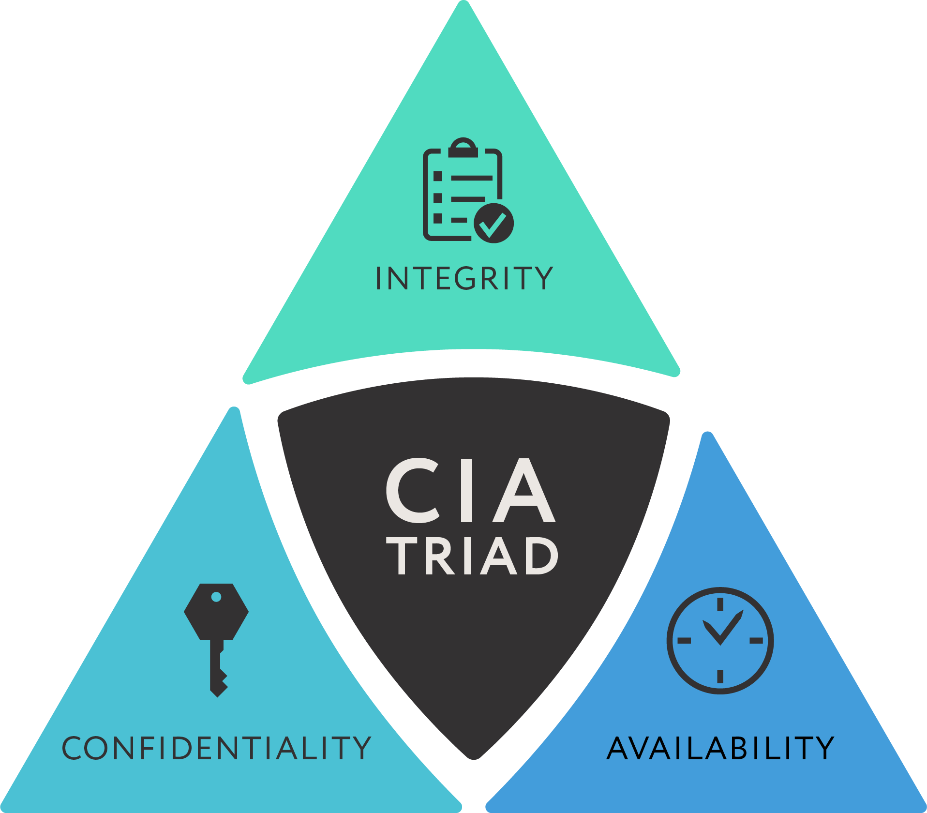
The CIA Triad
Notes:
This slide shows a graphical representation of the CIA Triad

Slide 5
C I A = Goal of Network Security
Data (aka information) is an Asset. The goal of cybersecurity is to maintain…
  Confidentiality
  Integrity
  Availability
Data is not revealed
Data is intact – not modified or corrupted
Data is accessible to allowed users
Notes:
These three words are clearly familiar but how do they apply to data?
1. Confidentiality – the data is not revealed to anyone except those it is meant for. Even if something isn’t super secret, there is a set group of people who should see the data and no one else should be able to.
2. Integrity – most people think of this word in its common definition: “the quality of being honest and having strong moral principles; moral uprightness”. But in terms of data, we use the secondary definition for integrity:” the state of being whole and undivided”. By maintaining the integrity of data, we are ensuring that it stays in its original state and is neither changed nor damaged.
3. Availability – essentially this means I need the data to be there when I need it. If the data is stolen, goes offline, I can’t reach it, etc – then it is not available!

Slide 6



Confidentiality
Protection against unauthorized access
Oh, they’re releasing on the 17th, let me tell the newspaper
We’re going to release the game on the 17th
Notes:
This slide shows confidentiality and how it’s broken here because the malicious actor can gain information from the employees and share it to the newspaper

Slide 7

Integrity
Protection against unauthorized modification
Let me change that to the 21st
We’re going to release the game on the 17th
We’re going to release the game on the 17th
We’re going to release the game on the 21st
Notes:
This slide shows an example of when integrity is breached when the malicious actor changes the date of the launch that is told to the other employee

Slide 8


Availability
Protection against denial of service
We’re going to release the game on the 17th
?
Notes:
This slide shows a loss of availability where the two employees are unable to communicate with each other

Slide 9
Data “states”
To protect the CIA of data, we need to know what “state” the data is in and then we can apply the right cybersecurity tool.
Data at Rest = storage → information is at rest; usually files, databases, etc stored on hard drives, USB drives, memory, DVDs
Data in Transit = transmission → being moved from one system to another or file sharing on a LAN or transfer on the Internet, etc.
Data in Use = processing → file creation by user, data used in an application, being processed or placed in memory, etc.
Notes:
The public view of cybersecurity is that there is a blanket approach to securing all data. But in fact, there are many different facets to examine before applying the correct type of security. One of those facets is the “state” of the data ‐ if it is in storage, then we can use a certain type of encryption and put certain types of alarms and access controls on it for when someone tries to touch it. If the data is moving across the Internet dynamically, then a completely different type of encryption would be used and methods like firewalls would be used. You see the point ‐ security changes when the data is at rest, in transit or in use.

Slide 10
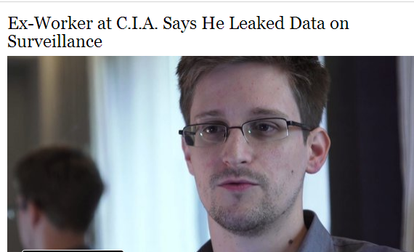
Breach of CIA examples
Loss of Confidentiality
Stolen data that was made public
NSA leaks of government data by
Edward Snowden
NY Times 6/9/13 Credit:Glenn Greenwald/Laura Poitras/European Pressphoto Agency
Notes:
On each of these CIA example slides there is a story to help the students understand how these breaches look in real life.
First real life example on a breach of CIA is loss of confidentiality, stolen data that was made public. Well, in 2013 Edward Snowdon was a contractor for the NSA, the national security agency. And he stole data that he felt should be public, and then gave it to WikiLeaks which published it online. So, this is a perfect example of loss of confidentiality. What he did is also known as Doxxing, a term to describe where you expose documents or private information. You can doxx somebody, celebrities have been doxxed, it's kind of like a threat or blackmail. A private doxxing is usually done in terms of getting out people's private phone number, or private home address . So, loss of confidentiality can be from corporate or government data being made public or just from your own personal private data being made public But everything else is probably the most famous recent example of a loss of confidentiality
Reference NY Times article
https://www.nytimes.com/2013/06/10/us/former-cia-worker-says-he-leaked-surveillance-data.html
Ask students if they can think of other current event examples where the confidentiality of data is an issue.

Slide 11
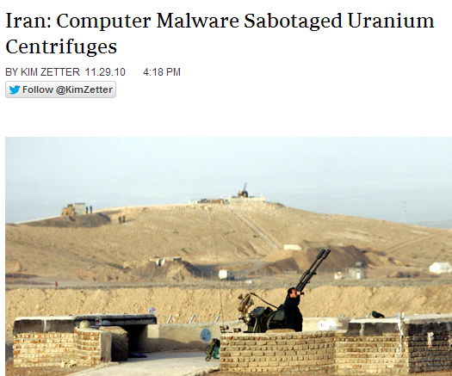
Breach of CIA examples
Loss of Integrity → Data that was corrupted
STUXNET worm – changed the code on the centrifuge machines in an Iranian nuclear facility so that they ran at too high a speed.
https://www.wired.com/2010/11/stuxnet-sabotage-centrifuges/
Notes:
One of my favorite examples of a CIA loss of integrity breach is Stuxnet, which we'll talk about more in the malware section. But it's a perfect example of how data that's corrupted or modified can have tremendous consequences. So, somebody wrote some code called the Stuxnet worm, which was targeted at the Iranian nuclear facilities. It specifically was intended to keep the Iranians from processing uranium to make it weapons grade. The code was intended to only activate if it ended up on computers that were in the Iranian nuclear facility. And what it did was it modified the centrifuge machine speed so that it went so fast that they essentially broke. And the Iranians had to keep replacing the centrifuge machines, because they basically didn't realize that it was code that was causing this problem and not some sort of physical problem. So, highly effective use of loss of integrity
Reference Wired Article:
https://www.wired.com/2014/11/countdown-to-zero-day-stuxnet/
Ask students if they can think of other current event examples where the integrity of data is an issue.

Slide 12
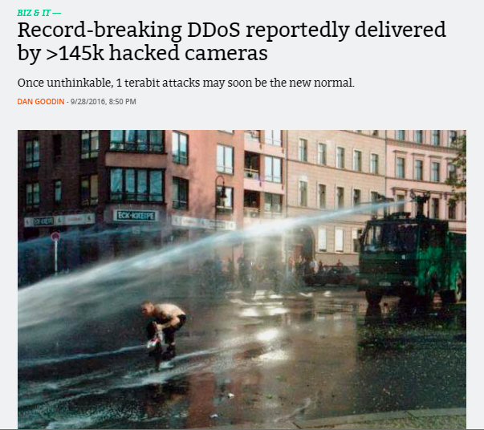
Breach of CIA examples
Loss of Availability → Data is inaccessible
A common reason is a DDoS attack = Distributed Denial of Service
Mirai Botnet takes down website of
cybersecurity reporter Brian Krebs– mad
about an article he wrote, hackers infected
more than 145,000 internet-attached devices
like cameras and ordered them to flood Krebs’
website with traffic. It was like getting hit with a
massive firehose and the site crashed for 4 days.
https://arstechnica.com/information-technology/2016/09/botnet-of-145k-cameras-reportedly-deliver-internets-biggest-ddos-ever/
Notes:
Finally, here’s a breach of CIA example that addresses Loss of Availability, remember that’s when data becomes inaccessible and one of the most common reasons for that is a Distributed Denial of Service attack, a DDOS attack. Malicious actors often want to “take down” the websites of their competitors or just people who make them mad. One way to do this is with a DDOS which is when you send a website so many requests that it’s like hitting them with a firehose. They collapse from too much traffic hitting the site. In 2016, Brian Krebs, a well‐known cybersecurity reporter, wrote a blog identifying the two creators of a DDOS‐for‐hire service. That made the malicious actors super mad and they turned the firehose on him which turned out to be the biggest DDOS ever seen on the internet at the time. They reached massive size by infecting home routers and cameras with the Mirai malware, turning them into a global botnet of small devices. The malicious actors commanded the botnet to send traffic to Krebsonsecurity.com, hitting the site with over 650Gbs for days. Now Krebs gets hit with DDOS attacks pretty regularly but he had been shielded by Akamai, a cybersecurity protection firm. But Akamai actually had to protection for drop Krebs because this massive attack was draining all their resources. Krebs was saved when Google Project Shield agreed to take on his protection. Project Shield is a free service that defends news, human rights and election monitoring sites from DDoS attacks. With Project Shield’s ability to take on gigantic traffic, Krebs’ website came back online and was again Available. We’ll hear lots more about the Mirai botnet and Project Shield later in this course.
Reference ArsTechnica article:
https://arstechnica.com/information‐technology/2016/09/botnet‐of‐145kcameras-reportedly‐deliver‐internets‐biggest‐ddos‐ever/
Ask students if they can think of other current event examples where the availability of data is an issue.

