Slide 1

Scarcity and Opportunity Cost
The Economic Problem

Slide 2
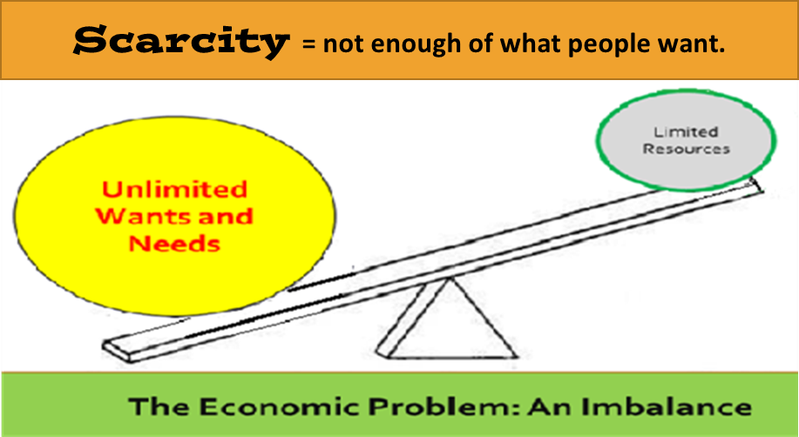
What is considered the
Economic Problem?
Scarcity

Slide 3
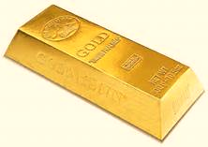
What is SCARCITY?
A. When things are in short supply
B. NOT enough of something that people want and need
Some resources are more scarce than others. Example: Gold and Diamonds

Slide 4
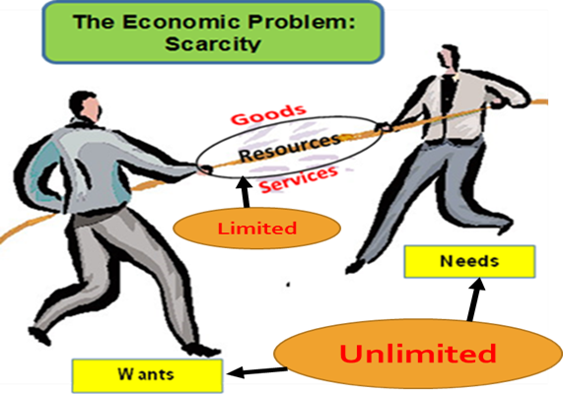
Why is SCARCITY considered a problem?
People have UNLIMITED wants and needs, but there are a LIMITED amount of resources to meet their demands.

Slide 5
What is the affect of scarcity for economics?
A. Due to the scarcity of resources, people have to make a lot of CHOICES.
a. Choices made by:
    Consumers: What to buy, trade, or use?
    Businesses: What resources to use and what products to produce?

Slide 6
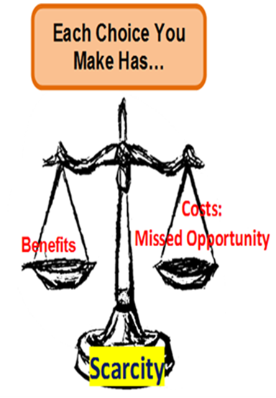
What does each economic choice we make have?
A. Choices have CONSEQUENCES and VALUE:
1. Benefit
2. OPPORTUNITY COST

Slide 7
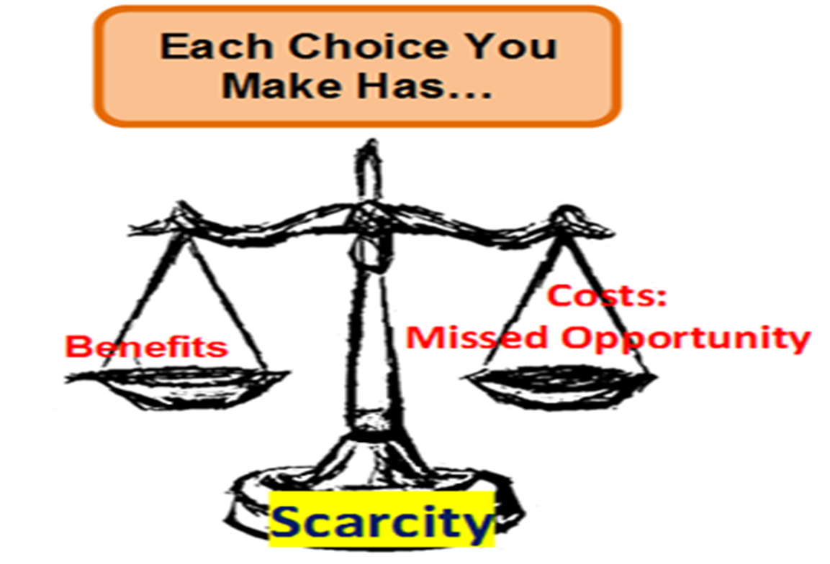
What is
OPPORTUNITY COST?
The missed opportunity or what you gave up for
making the choice or purchase.
For example: You decide to spend money 0n a four year college degree.
Benefit:
Earned college degree
Opportunity Costs: Missed:
Earning money from a job
Time with friends
Getting job experience and skills
Spent $40,000.

Slide 8
The Economic Problem
Scarcity
Resources :
goods and services
Forces Choice
What to buy, use, or sell?
Value of Choice
Benefits
Opportunity Cost

