Slide 1
Basic Computer Care
Computer Maintenance for your Personal Computer
Specifically for PCs

Slide 2
HOW TO CLEAN YOUR LAPTOP
DO
DO NOT
Clear surface dust with a microfiber cloth
Screen-cleaning kit
Use compressed air or a vacuum to remove crumbs from keyboard
Use a 70-percent isopropyl alcohol solution (aka rubbing alcohol)
Q-tips for the keys
Use Clorox wipes
Spray onto the computer
Eat by your computer
Leave open drinks by your computer

Slide 3
HOW TO START YOUR COMPUTER
1
Press the power button
2
Wait for the computer to boot
3
Log in with your username and password

Slide 4
HOW TO TURN OFF YOUR COMPUTER
Click the Windows button at the bottom left-hand corner of your screen
Click Shutdown
Wait for the system to power itself down

Slide 5
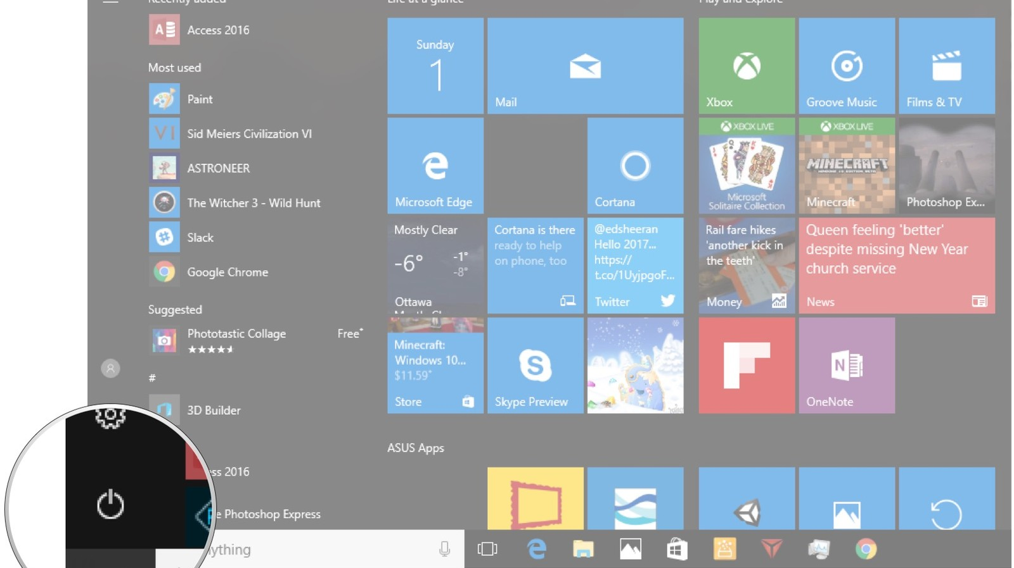

Slide 6
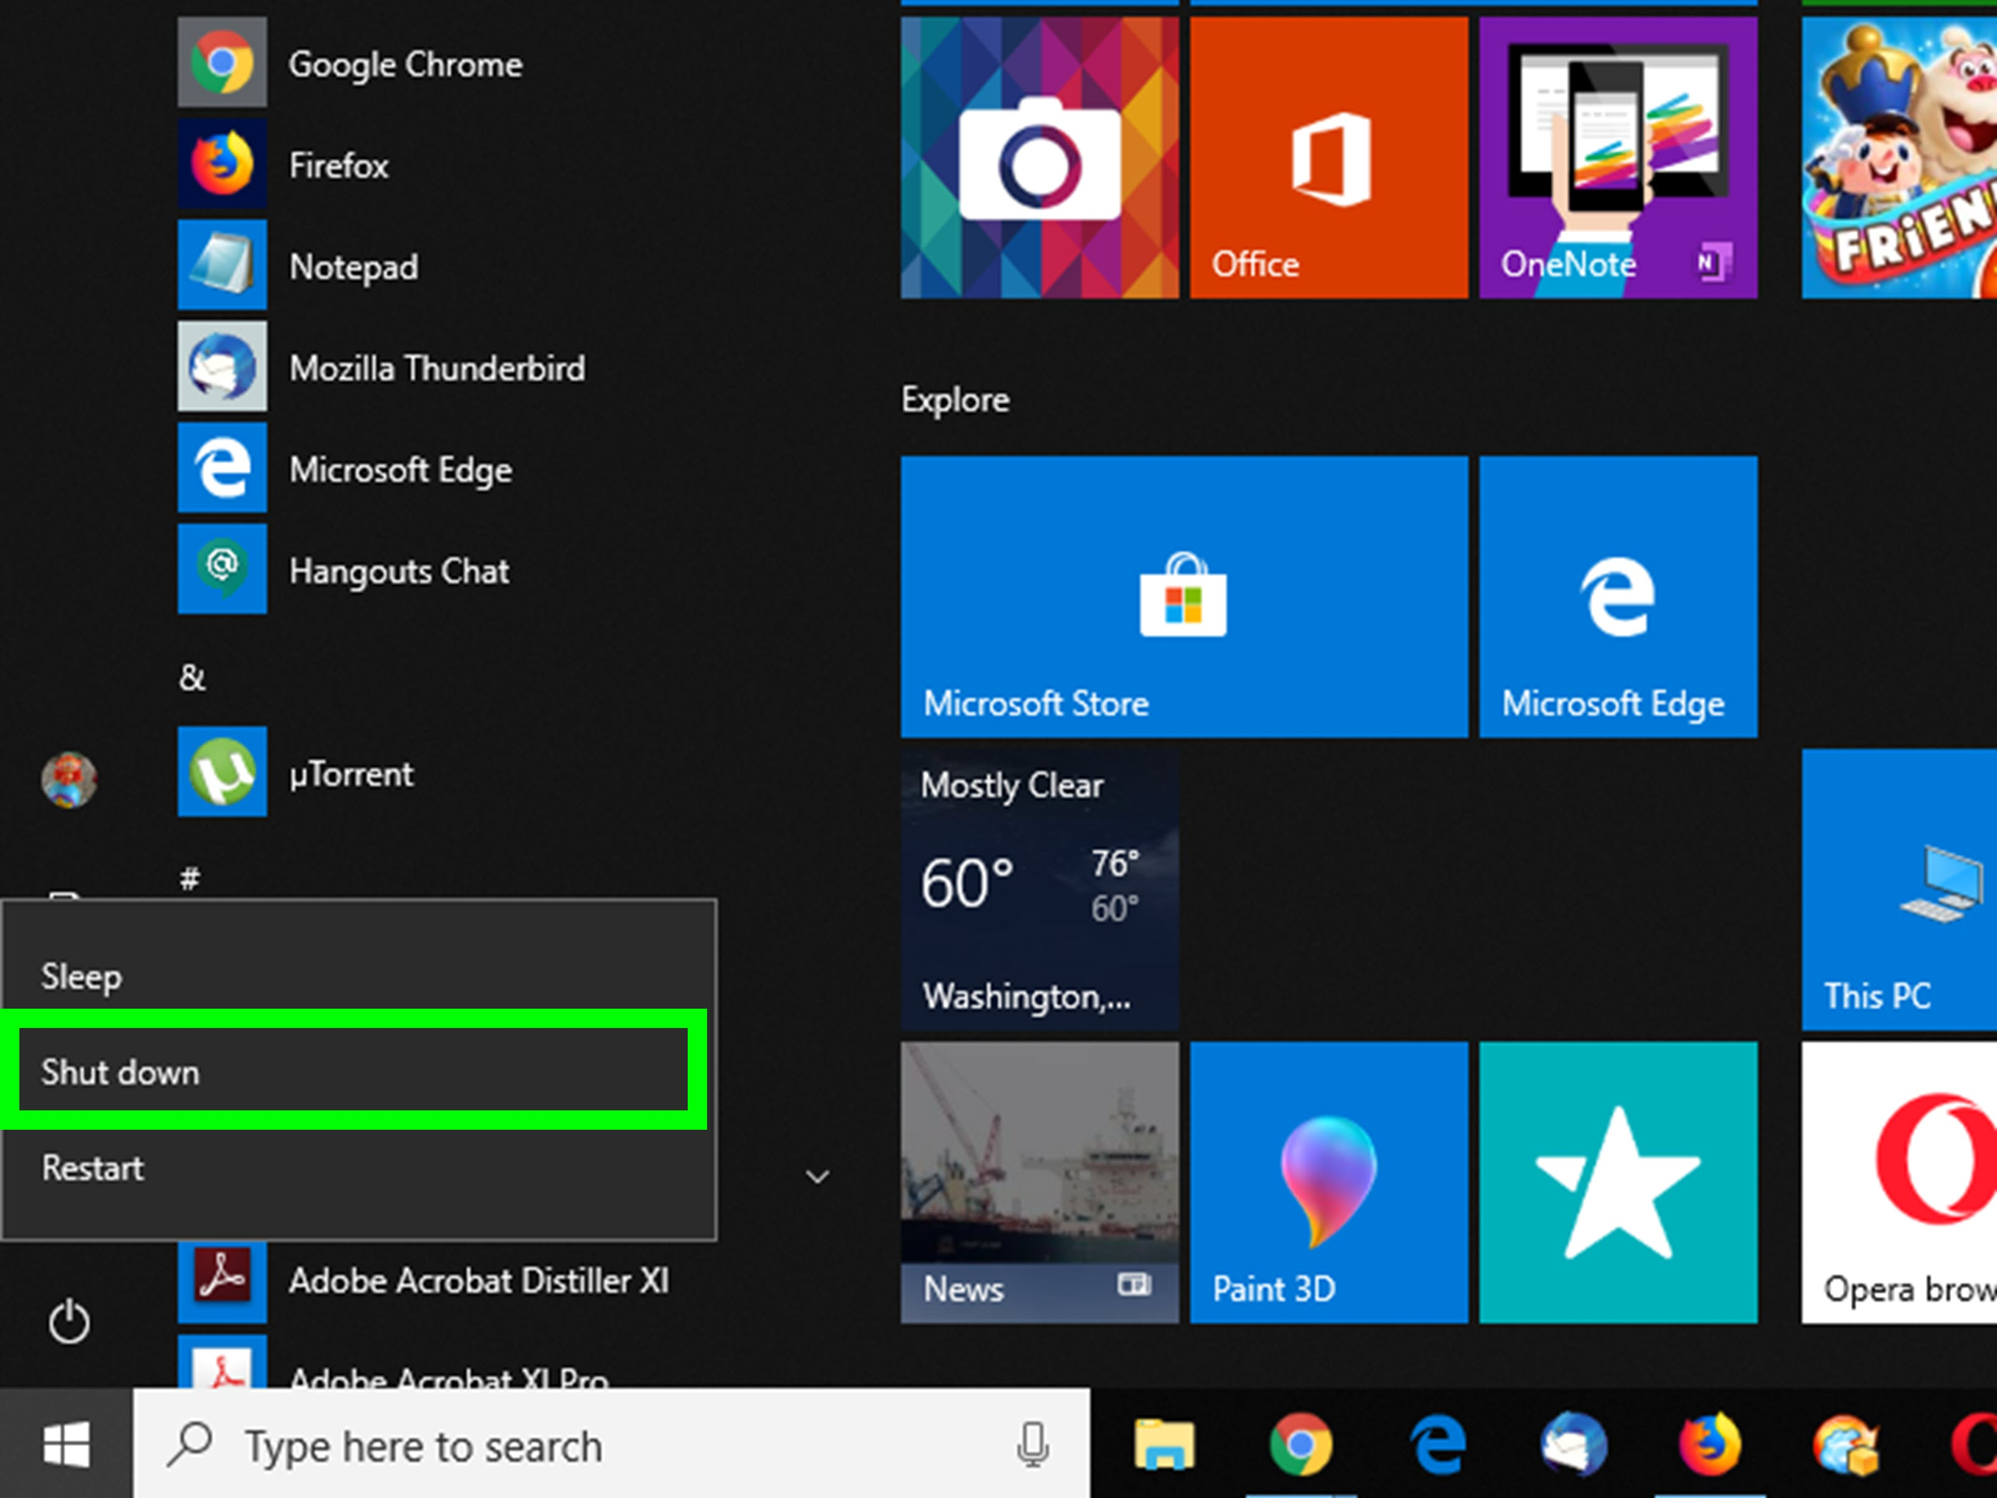

Slide 7
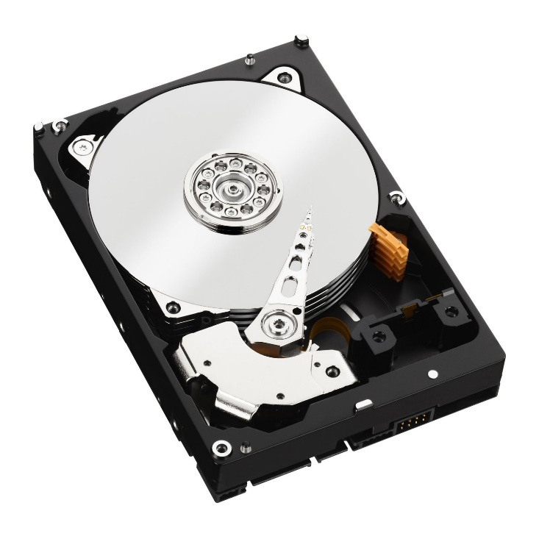
DO NOT SHUT OFF YOUR COMPUTER WITH THE POWER BUTTON!
Cause serious file system damages
Operating systems are constantly running and have a proper shut down sequence they follow
Reduces a hard drive’s physical lifespan
Eventually destroy the hard drive
This Photo by Unknown Author is licensed under CC BY

Slide 8
WHAT IF MY COMPUTER IS FROZEN?
Wait
Press CTRL+ALT+DEL
Open the Task Manager
Close any not responding tasks

Slide 9
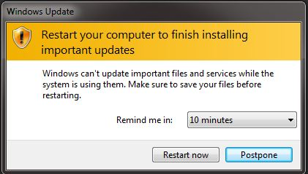
COMPUTER UPDATES
Fix the software or hardware installed
Help your computer last longer
Make your computer run faster
Increase security

