Slide 1
Lesson 1: Talking to Machines
Problem Solving with AI

Slide 2

Do This:
Start with the following phrase:
A mysterious talking cat started showing up to math class.
In your group, take turns building on the conversation by starting your next sentence with "Yes, and . . ."
Notes:
Yes, and…
☑️ Do This: Group students in pairs or groups of three and read aloud the sentence on the board. Have students take turns one-by-one building on the conversation by starting their next sentence with "Yes, and.."
Teaching Tip
For example:
Opening Statement: "A mysterious talking cat started showing up to math class."
Student 1: "Yes, and he said his name is Whiskers."
Student 2: "Yes, and he happens to be very good at multiplication."
Student 1: "Yes, and he has a sister who started showing up to English class."
(Optional) If you have time to play multiple rounds of the game, here are some additional opening statements:
"The class down the hall just discovered a hidden tunnel beneath the school."
"The principal announced that prom will be held on a spaceship this year."
"Every locker in the main hallway suddenly started playing music."

Slide 3
Everyone thought it was a prank
AI Connections
Yes, and…
A mysterious talking cat started showing up to math class.
She always sat in the front row
Yes, and…
Yes, and…
The teacher tried to shoo him away
Notes:
☑️ Do This: Have students read the different sentences on this slide.
🎙️ Say: Generative AI is like a “Yes, and” machine. It builds on existing sentences by finding a word or phrase that would make sense to come next.

Slide 4
Explain that AI models use probability and statistics to generate responses.
Experiment with different prompts to observe how AI's responses change.
Analyze patterns in AI-generated responses to explain how input prompts influence outputs.
Refine AI-generated outputs by iterating on prompts and recognizing patterns in responses.
Notes:
☑️ Do This: Introduce the lesson objectives.

Slide 5
How can I use AI effectively?
Notes:
☑️ Do This: Introduce the Question of the Day.

Slide 6

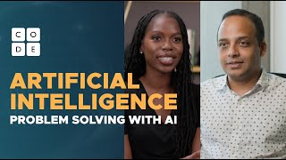
Video: Problem Solving with AI
Notes:
🎥 Video: Show Problem Solving with AI video.
Teaching Tip
To encourage active engagement and reflection, use one or more of the strategies discussed in the Guide to Curriculum Videos.

Slide 7
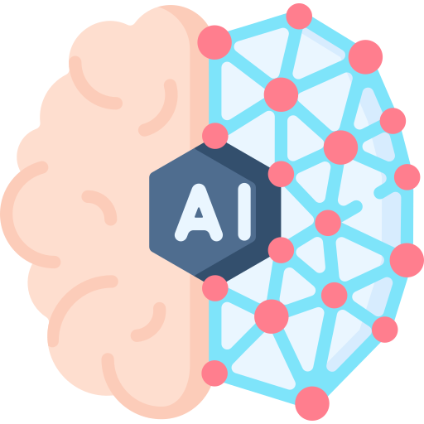
What is AI?
Artificial intelligence (AI) is a technology that mimics human intelligence, performing tasks such as understanding language, recognizing patterns, and making decisions.
📝 Unit Guide
Notes:
AI Predictions (10 mins)
☑️ Do This: Define artificial intelligence.

Slide 8

What is Probability?
When making predictions, probability takes into account the likelihood that a specific outcome might occur.
📝 Unit Guide
Notes:
☑️ Do This: Define probability.

Slide 9


Successful Predictions
Complete the following sentences:
"He heard a knock at the…"
"Thank…"
"As the bell rang, they put down their…"
"He heard a knock at the… door"
"Thank… you for your help"
"As the bell rang, they put down their… pencils"
Notes:
☑️ Do This: Read through this scenario of probability-driven predictions that make sense and are successful. Make sure students understand that the grey box represents the user input, and the blue box below represents the AI Chat response.
🎙️ Say: AI uses the computational skill of pattern recognition to generate its most likely response. For example, it reads over thousands of sentences that contain the different phrases above (e.g. "heard the knock at the…") and starts to recognize a pattern.

Slide 10

Failed Predictions
Draw "the keys are on the table".
Probability-driven predictions can fail because they don't rely on meaning.
Notes:
☑️ Do This: Examine this scenario where probability-driven predictions fail because they don't rely on meaning.

Slide 11
Why Did the AI Fail?
Draw "the keys are on the table".
The AI focused on the words "keys", "on", and "table" and abstracted away unnecessary details of the prompt.
Notes:
☑️ Do This: Explain that AI focused on the words "key", "on", and "table" and abstracted away unnecessary details of the prompt.
🎙️ Say: Since AI doesn't understand meaning, it drew a single key resting on the table in an unrealistic way. It prioritized the literal meaning of the essential details of the sentence rather than considering the sentence as a whole.

Slide 12

What is Abstraction?
Abstraction is the process of focusing on only the essential details of a problem and ignoring everything else.
Notes:
☑️ Do This: Define abstraction.
Teaching Tip
Abstraction is one of the four pillars of computational thinking– a framework designed for solving problems. This concept will be repeated throughout AIF units.

Slide 13

What is a Prompt?
A prompt is a question, instruction, scenario, or statement provided by the user to guide the AI's response.
Notes:
Prompting AI (20 mins)
☑️ Do This: Define prompt.

Slide 14
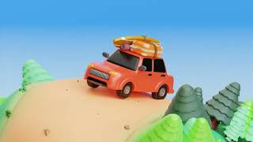
Video:
What tips might you give to someone else who is looking to improve their prompts?
Notes:
🎥 Video: Show the "Plan a Perfect Trip with ChatGPT" video.
Questions to consider with the video:
What tips might you give to someone else who is looking to improve their prompts?
💡 Discussion Goal: Students might point out that they should include both information that they are interested in getting, but also information that they are not. They might also mention that including demographic information and specific numbers are helpful for more useful responses.
Teaching Tip
Videos are used throughout the curriculum to spark discussions, supplement key concepts with additional explanations and examples, and expose students to the various roles and backgrounds of individuals in computer science.
While interacting with the video, turn on closed captioning so students can also read along as they watch.
To encourage active engagement and reflection, use one or more of the strategies discussed in the Guide to Curriculum Videos.

Slide 15
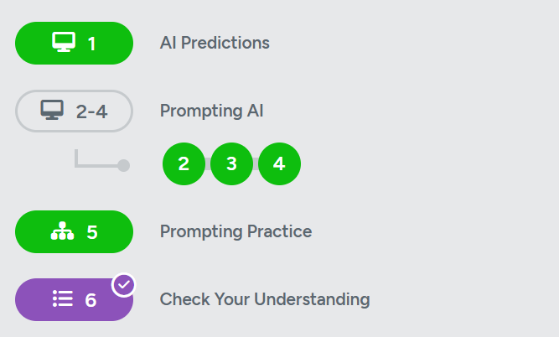
Complete the activities online

