Slide 1
5-2 Network Components

Slide 2
What Do We Need To Make A Network?
Computers that WANT to share:
  Hosts: client workstations, laptops, servers
A way to connect the different parts:
  Media: cables or air
A place for them all to connect:
  Network Devices: hub, switch, router
Things to share:
  Peripherals: printer, scanner, copier, modem
Data to share:
  Services: files, website, email
Notes:
We can use this list to define the components of a network. Take a minute to read through the list, emphasizing the terminology in bold, especially “media” which students will usually associate with news or online sites. In networking, “Media” = the physical method of carrying electrical signals.
Click to bring up a red rectangle which highlights bullets #3. This presentation will look at how we physically connect networks.

Slide 3
Definition: What Is A Network?
A group of 2 or more computers connected to one another in a way that gives the computer users simultaneous access to the same data, resources, and applications.
But most networks have
more than 2 devices!
Notes:
Let’s start with the definition of “network”.
2 or more computers - or phones or printers or any device that has a NIC (Network Interface Card)
simultaneous access - think about it . . . people on the web don’t take turns getting to Hulu to watch their show or wait their turn to get on Amazon to make purchases. Those websites are shared data and the devices that host them are networked so that any user, any time can have access.

Slide 4
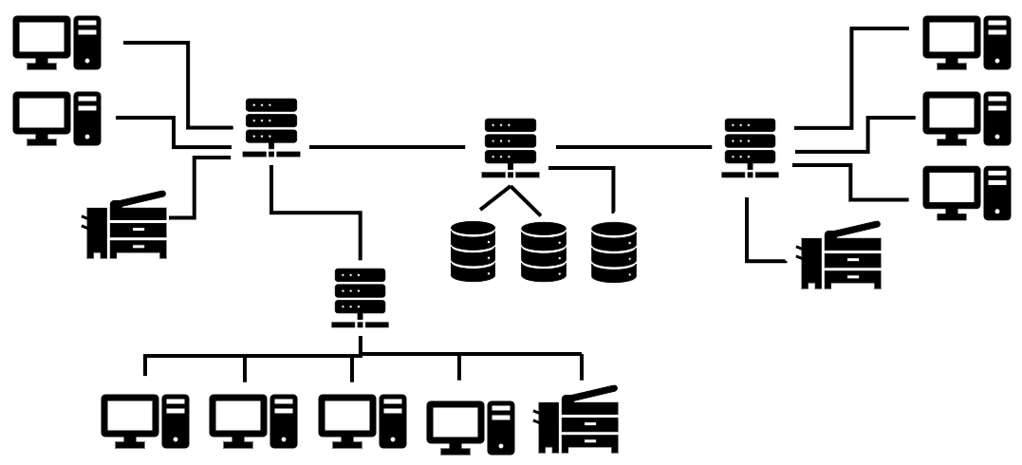
LAN - Definition
LAN - Local Area Network = devices connected inside a home, office, building, or small geographic area for LOCAL sharing of resources such as files, printers, applications, etc.
A LAN can be two
connected computers or
it can be thousands of
connected devices.
IMPORTANT: Must share a common IP address numbering range
Notes:
Most networks that you are part of are Local Area Networks (LAN). The school network, the Wifi network at the coffee shop, your home network - these are all intended to connect a finite group of devices within a limited geographic area.
KEY POINT: All devices in a Local Area Network must have the same IP address numbering range. This concept will be expanded upon through Section 4.2 lessons but we introduce it here.

Slide 5
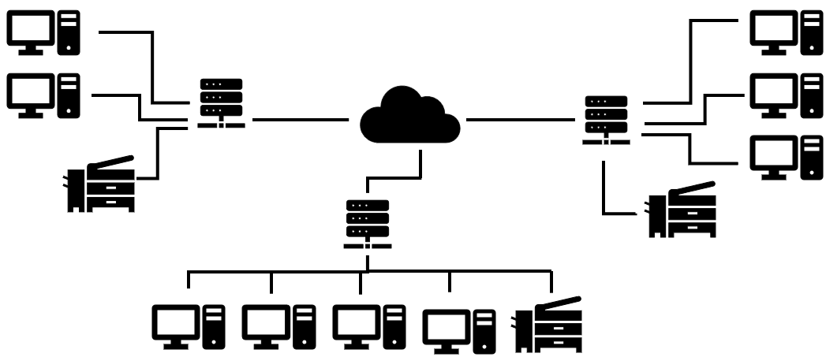
WAN - Definition
WAN – Wide Area Network = devices connected across a wide geographic area. Usually, a collection of connected LANs
The INTERNET is the largest WAN and is represented graphically as a cloud.
Notes:
A Wide Area Network is usually a collection of LANs connected to each other. Examples of WANs are large companies such as Exxon that have offices (LANs) all around the world that are connected together (WAN). Another example are some cities provide connectivity to all their municipal entities like courts, schools, police, fire, town hall. Each of those entities runs their own LAN then connect via the city WAN.
The most obvious example of a WAN is the Internet - and it is the largest possible WAN since it connects devices globally.

Slide 6
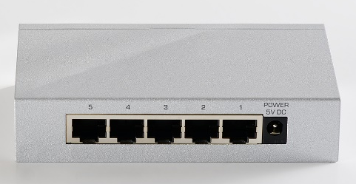
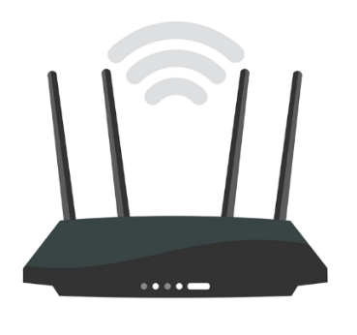
Connection Devices
LAN connection devices = hub, switch, WAP
Hub – sends the message to everybody = a “broadcast” message
  like yelling to everyone in a room
  These are considered “dumb” devices because they just move the signal along
Switch – sends the message only to the destination device in the LAN
  like making a local call directly to one person
  directs signal only to correct device using MAC address
Wireless Access Point is just a switch without wires
Ports
Notes:
What hardware does it take to deliver data?
To connect devices in a LAN, the choices are hub or switch. Hubs were the original central connection device but are now rarely used because there is no management of delivery. When a message comes into a port on a hub, it goes out every other port. This is known as a “broadcast” message. When several messages are trying to use the same port or cabling, they will collide, the message is dropped and must be resent. In situations with a lot of message traffic, the network can become very slow.
Most LANs today are connected by switches because they efficiently deliver the message only to the destination port. The next two slides show animations of these behaviors to reinforce the difference between hub and switch.

Slide 7
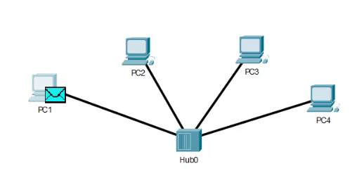
Packet from PC1 to PC4 via Hub
Don’t know who this goes to, and I don’t care – that’s not my job!
HUB
I’m sending it to everybody! Woohoo!
Notes:
Click to start the video animation but wait because there is a 2-3 second delay. The packet will start moving then 2 callouts will appear automatically.
This demonstrates how a packet is delivered in a LAN of 4 computers connected by a HUB.
PC1 sends a packet to PC 4.
The hub is a “dumb” device so it just pushes copies of the packet out all connected ports.
PC2 and PC3 look at the packet addressing and drop it because it is not addressed to them.
PC 4 keeps the packet.

Slide 8
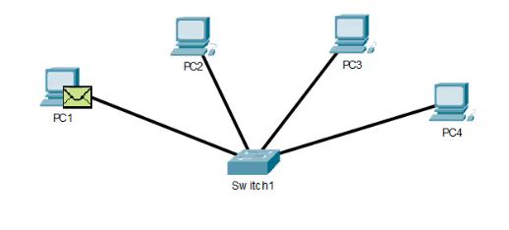
Packet from PC1 to PC4 via Switch
I keep track of which computer is on which port – I’m very smart!
SWITCH
I’ll send this message ONLY to the addressee.
Notes:
Click to start the video animation starts on click. The packet will start moving then 2 callouts will appear automatically.
This demonstrates how a packet is delivered in a LAN of 4 computers connected by a SWITCH.
PC1 sends a packet to PC 4.
The Switch is a “smart” device so it knows which port PC 4 is on and only sends the packet out that port.
Only PC 4 receives the packet.

Slide 9
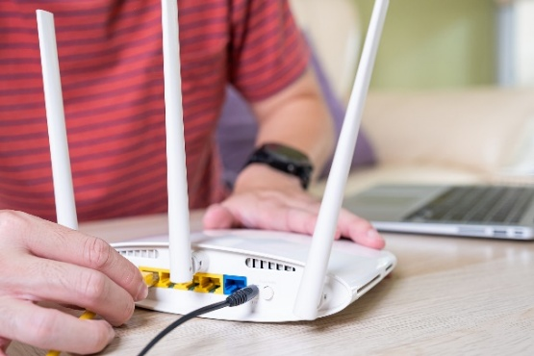
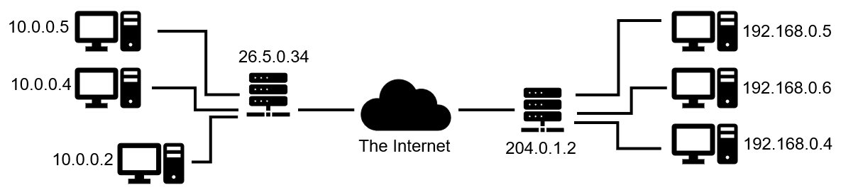
Connection Devices cont’d
WAN connection = router
Router – sends the message only to the destination device in the LAN or in the WAN – like making a long-distance call directly to one person.
Important! – A router is the only device that can connect two networks together. AKA “Gateway”
Notes:
What hardware does it take to deliver data?
To connect devices BETWEEN different LANs you must have a router. ONLY a router can make WAN connections.
Remember, whenever a host joins a network it gets an IP address. If the host wants to send data to a host in another network, it needs a router.
Aka “Gateway” – because the router is the door out of the network . When a packet is sent with a destination IP address that is outside of the local network, it is automatically sent to the IP address of the “default gateway” – i.e. the router responsible for our LAN. All IP address configurations on devices must have a setting for the default gateway so that there is somewhere to go for unknown addresses.

Slide 10
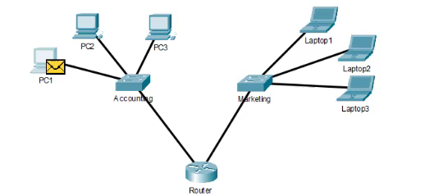
Accounting PC1 to Marketing Laptop 3
I belong to both the Accounting AND the Marketing networks.
And I talk to my router friends, so I know about other LANs
Routers know EVERYONE so you can count on us to send it to the right place!
ROUTER
Notes:
The video animation starts on click.
This demonstrates how a packet is delivered between 2 Local Area Networks (LANs) - from PC1 in the Accounting LAN to Laptop 3 in the Marketing LAN.
PC1 has IP address 192.168.1.1 Laptop 3 has IP address 172.16.2.35
Clearly they are not in the same network so they would not be able to communicate if connected by a switch or hub.
The router has one port in the 192.168.1.x addressing and the other port in the 172.16.2.x addressing. This is how it is able to “route” packets between two LANs. If the router doesn’t have a port in the destination network then it will send it to the next router . . . and so on and so on. Routers DO exchange information about other routers so they can keep track of possible paths for messages. They keep a kind of mental map of the routers around them. That’s the Internet!

