Slide 1
5-4 Packet Delivery and Protocols

Slide 2
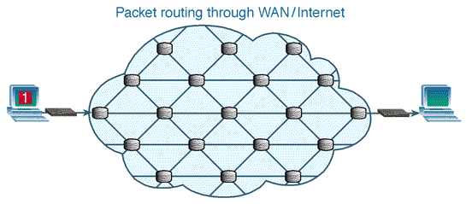
Digital Packets
Digital communications use packet switching to break up the signal into pieces and send them on different paths.
Source: https://internet.tolearn.net/internet-and-transport-layer/
Notes:
In the next few slides we will go over the key methods used by packet switching
Point out that the first packet in the animation goes in a straight path, but then the next few packets take an indirect route. This is because every millisecond the routers are estimating what is the fastest path to a destination and the conditions of these paths change quickly. A router along one path could go down or there could be a spike in traffic – it’s very much like cars and roads. Sometimes the superhighway is the fastest but sometimes you look at Google maps and realize there’s an accident so taking the local road will be faster. Routers keep in touch with each other so they can be up to date on current network traffic conditions.

Slide 3

Digital Packets: Analogy
Analogy: A Set Of Postcards
The message is broken up into parts – each part is written on a separate postcard. The postcards are numbered.
Each postcard could take a different route to get to the receiver. They will probably arrive out of order.
When the receiver gets the postcards, they use the numbers to put them in order and to figure out if all of them have been received. THEN they can read the entire message.
Part 3 of 3
you send me a check?
Love, your son
Part 1 of 3
Having a great
time. The weather
is
Mom
1 Main St
USA
Mom
1 Main St
USA
Part 2 of 3
fine. I am running out of money - could
Mom
1 Main St
USA
Notes:
Let’s connect this to Mobster Net – taking different paths is like using different janitors, sometimes it’s fast, sometimes it’s not. To deal with issue, packet switching uses a numbering system as illustrated in the slide postcards. This is so that the receiver will be able to tell WHEN they got all the messages segments and WHAT ORDER to put the segments in. Ask the students how many of their groups came up with a similar system for their Mobster Net protocol? Kudos to those who did!

Slide 4
Protocols
To deliver packets in a network, there are rules that govern how data will be transmitted.
These rules are called protocols and the largest, most important set of protocols is the TCP/IP suite.
TCP/IP is a set of over 100 protocols that determine the rules for how a TYPE of data will be exchanged between two computers.
It is named after TCP and IP which are the main protocols that do most of the heavy lifting in network communications.
Notes:
We have established that packet delivery in a network needs rules (aka protocols) and the students have even invented their own protocol for message delivery.
The TCP/IP (Transmission Control Protocol/Internet Protoctol) is a set of a LOT of protocols. These protocols are in a suite because they have been standardized to work efficiently together. TCP/IP was created by the Defense Department as part the ARPANET project which went on to become the Internet. It is now the basis for transmitting all the different types of data used in networks – email, file transfers, streaming video – you name it, it is probably using TCP/IP as the primary protocol.
What’s the alternative if we don’t use TCP/IP? Well, there used to be several – MAC computers used to use the Appletalk protocol, Windows computers used the NetBIOS protocol and Novell computers used the IPX/SPX protocol. But these protocols couldn’t be used outside of a private network so when the Internet became popular almost all networks switched to using TCP/IP exclusively.

Slide 5
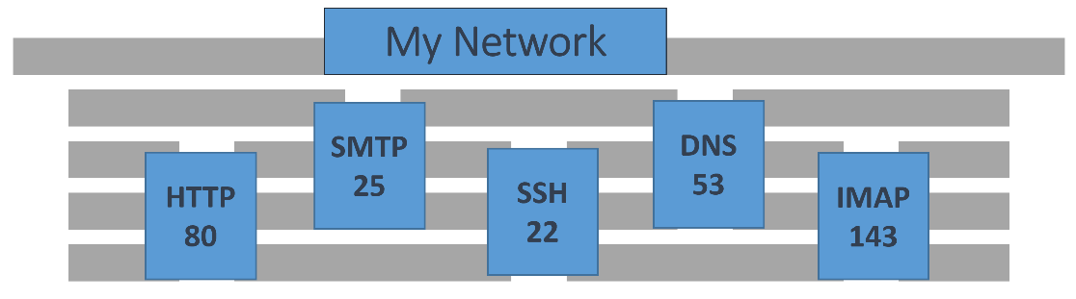
Protocols & Ports
Most protocols are associated with a specific port number. The port number indicates to the computer which application should handle the incoming data.
Ports are like doors – they are openings to handle a specific type of packet.
Example: a web browser uses the HTTP protocol which usually uses Port 80. This port is not mandatory, but a website that is NOT listening on Port 80 will have to let each user know the custom port that is being used.
Notes:
When a packet is sent out it includes not only the destination IP address but also a port number. Each port number accepts a different kind of data. Here’s an analogy to clarify this concept:
Let’s say I want to send my son to get some milk from a store. I will give him this instruction: “Go to the building at #2 Main Street and knock on the Red door.” The IP address is #2 Main Street and the Port number is “Red door.” The Red door only handles requests or deliveries of milk, so my son will get exactly what is needed if he follows directions.
Looking at the slide example, when I tell my browser to go to http://olympics.org, the browser knows to create a packet that will go to port 80 on the Olympics web server – because it is standard procedure for websites to use port 80 as their “door” for http requests.
Firewalls are often set to reject packets on certain ports. For instance, if you are not running a website in your network then you would close port 80 as there is no reason for anyone to be coming into the network through that port.

Slide 6
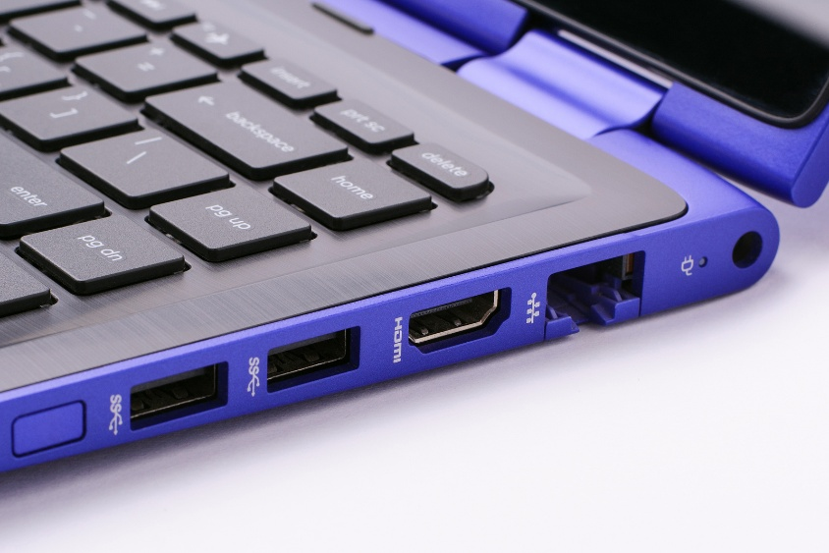
Ports: Physical or Virtual?
Physical: Ports that are used to connect your device to the network are called physical ports
USB or Ethernet
Virtual: A number assigned to a specific pathway of communication
Ports allow client computers to connect to a server using the port assigned to that service
Virtual ports help manage network traffic by using assigned port numbers, from 0 through 65535
Notes:
Quick pause to straighten out the difference between physical ports and virtual ports. There are physical ports on devices that we can use to plug in things like Ethernet cables, flash drives, monitors, printers, etc. But the ports assigned to protocols are virtual ports which means they exist only in software code.
Think of a port like a TV channel. One cable connected to your TV, but delivering many channels.

Slide 7



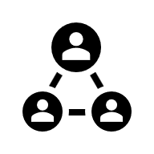

Well Known Protocols and Ports
File Transfer
  FTP – 20 (data)
  & 21 (control)
  SFTP – 115
Remote connection
  SSH – 22
  Telnet – 23
  RDP - 3389
Network Management
  DNS – 53
  DHCP – 67
Mail
  SMTP – 25
  POP3 – 110
  IMAP – 143
Web Browsing
  HTTP – 80
  SSL (HTTPS) – 443
But ALL packets need a “helper” protocol to handle the actual transport details. There are two -- TCP or UDP
Notes:
Here are the ports for some commonly used protocols. Since protocols and ports are used to deliver network data, these are key features in any hacking attempt. For instance, FTP servers are known to have low security, so many hackers will try to use FTP or port 20 or 21 to break into a network. Alternatively, everyone should know by now that if you are using your credit card on a web page, you should check to see if it is using the https protocol as this is highly secure.

Slide 8
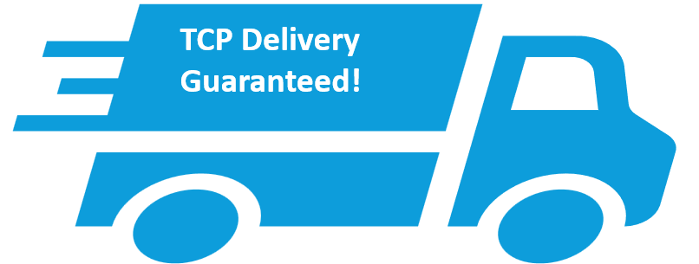
TCP - Transmission Control Protocol
Connection-oriented
Used to send data in a network
Reliable, keeps track of lost packets, keeps track of packet order, uses more CPU resources
Programs/services using TCP:
  Email
  Web browsing
  Many computer games
Notes:
The user or computer decides what application to use for the data – i.e. email, file transfer, web, name resolution, etc.
THEN the packet must use one of two carrier protocols, either TCP or UDP. These are sort of the mules of networking – they both will make sure there is a connection and they will both carry the data to the destination. BUT they have very different ways of performing this job. TCP will keep a connection going the whole time so that it can check that every packet in the message is being received. The truck image is meant to show that it is like UPS, it is reliable and that’s why it is called a “connection oriented” protocol. If the students were successful at Mobster Net, then they essentially invented TCP!

Slide 9
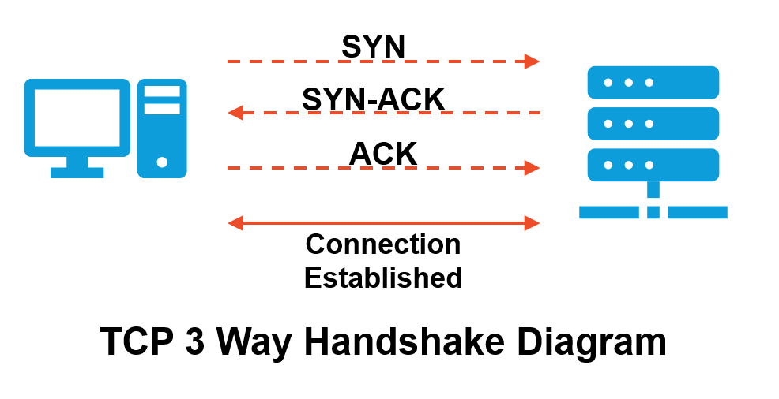
TCP – Connection-Oriented
3-Way Handshake
To establish a synchronized source-to-destination connection
between two PCs
Notes:
To achieve that reliable packet delivery, TCP uses a special technique called the “Three Way Handshake” to get the connection started. Here are the steps:
Sender requests a connection by sending a SYN (synchronization) packet
The receiver sends back two packets: one to acknowledge the request, the second to give information about how I like to connect (SYN/ACK)
The sender then sends a final acknowledgement to tell destination that “yes, we definitely have a connection – let’s start sharing data” (ACK)
And now the data transfer begins!

Slide 10


UDP - User Datagram Protocol
Connectionless
A much faster alternative to TCP for sending network traffic.
Unreliable, doesn’t keep track of lost packets.
Programs and services that use UDP:
  DHCP
  IP telephony
  DNS
  Music streaming
  Many games!
I don’t know and I don’t care but send it faster!
Did you get them all?
Data Packets
Notes:
UDP doesn’t keep a connection – in fact, it doesn’t care at all if the message got there.It’s a lot like tying the message to a rock and throwing it through the window. Yes, the message went to the right place but who knows if anyone got it or if it broke and lost some pieces. UDP gets there fast (because it’s not constantly checking) but it is completely unreliable.
The user doesn’t get to choose whether the packet uses TCP or UDP – that is determined by the software application protocol. For instance, HTTP is a connection-oriented protocol so it uses TCP. That means that if part of the website you are trying to browse isn’t getting to your computer, then there will be error messages so that the missing packets can be resent. On the other hand, TFTP is a connectionless protocol that is meant for speedy transfer of files without caring if there are errors.

Slide 11
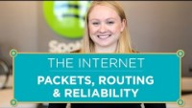
Wrapping It All Up
Network Addressing Summary
Who are you sending this data to?
MAC address
Where are you sending it?
IP address
What application are you
using?
Protocol port number
Method of delivery?
TCP or UDP
Notes:
A wrap-up slide to reinforce these key concepts about network addressing. The beginning of the video adds info to fill in some knowledge gabs about the role of routers in networks and then concludes with the TCP protocol.
Video: https://www.youtube.com/watch?v=AYdF7b3nMto&t=52s&ab_channel=Code.org 6:25 minutes

