Slide 1
Microsoft Teams 365
Module 1: Introduction to Microsoft Teams
© 2025 Cengage Learning. All Rights Reserved. May not be copied, scanned, or duplicated, in whole or in part, except for use as permitted in a license distributed with a certain product or service or otherwise on a password-protected website for classroom use.

Slide 2
Objectives
Describe the purpose of Microsoft Teams
Set up Microsoft Teams on your computer and mobile device
Navigate through the Teams interface
View your Teams calendar
Create a team
Add members and guests to your team
Post messages to your team
Upload files into Teams
Collaborate on a file in Teams
Make a voice call in Teams

Slide 3
Introduction to Microsoft Teams
Collaboration tool
  Connect to online meetings, exchange information, share files, and instantly assign tasks using peer-to-peer messaging, group chats, and feedback.
Video conferencing
Designed to support and improve internal and external communications

Slide 4
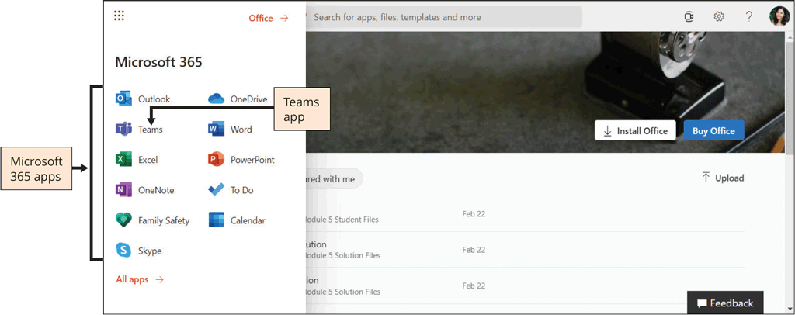
Collaboration with Your Colleagues
Notes:
Microsoft Teams is part of a Microsoft 365 subscription.

Slide 5
Collaboration with Your Colleagues
Microsoft Teams is a cloud-based communications platform that can be accessed on any device, even your smartphone
  On a computer, you can download the Teams desktop app
  Open the web version of Teams within any browser at the website https://teams.microsoft.com
  https://portal.office.com

Slide 6
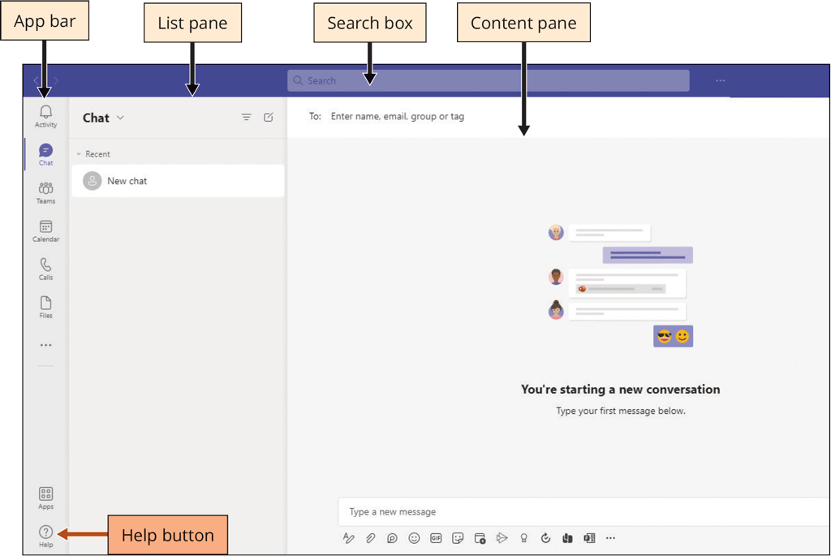
Collaboration with Your Colleagues
The main elements of the Teams window are:
  App bar
  List pane
  Content pane

Slide 7
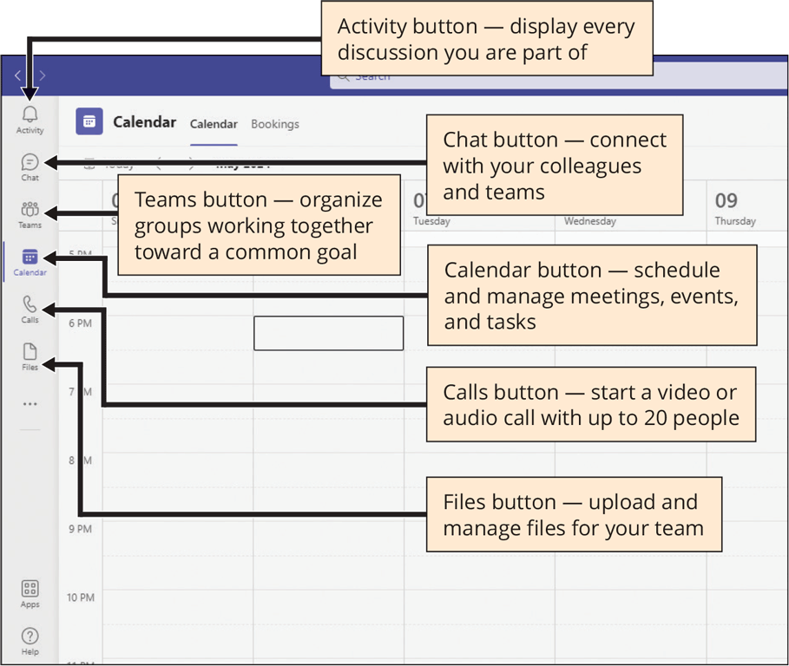
Collaboration with Your Colleagues
App bar buttons
  Activity
  Chat
  Teams
  Calendar
  Calls
  Files

Slide 8
Collaboration with Your Colleagues
App bar | The App bar is the vertical toolbar on the far left of the Teams window. Use the App bar to switch to another view or to an installed app within Microsoft Teams. The App bar buttons correspond to the views available in Teams, such as Activity, Chat, Teams, Calendar, Calls, and Files.
List pane | The List pane displays a summary of the selected view. For example, if you click the Chat app in the App bar, the List pane shows a summary of recent chats.
Content pane | The contents of the main content pane change according to which view is currently selected in the toolbar.

Slide 9
Collaboration with Your Colleagues
Button | Description
Activity | The Activity button is the main control for the App bar, connecting to conversations and meetings within your team.
Chat | The Chat button gives your team a space to continue a conversation. Chat happens in real time and decreases response time.
Teams | The Teams button is for creating teams that are focused on a project or a company department. A team is designed to bring together a group of people who work closely together to accomplish tasks.
Calendar | The Calendar button is for organizing and scheduling meetings, conversations, document edits, work shifts, and events.

Slide 10
Collaboration with Your Colleagues
Button | Description
Calls | The Calls button provides a quick way to connect to your colleagues. You can have one-on-one calls or calls with several members of your team at the same time.
Files | The Files button is one of the most powerful buttons in Teams. Select Files to upload and gain quick access to all the files you need in a certain project.

Slide 11
Working as a Team
Before starting your teamwork collaboration for any project, you need a team. To set up a team, you need:
  A team name
  A description

Slide 12
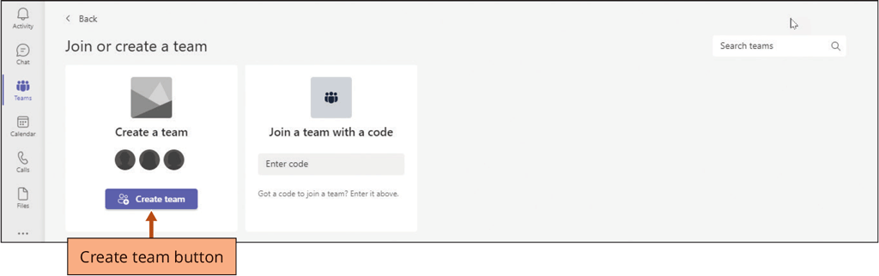
Working as a Team
To Create a Team
  Click the Teams button in the App bar
  Click the ‘Join or create team’ button in the Content pane
  Click the Create team button in the Content pane
  Type the desired name in the Team name box to enter a team name

Slide 13
Working as a Team
To Create a Team
  Type the desired description in the Description box to enter the team’s purpose
  Click the Next button to create the new team

Slide 14
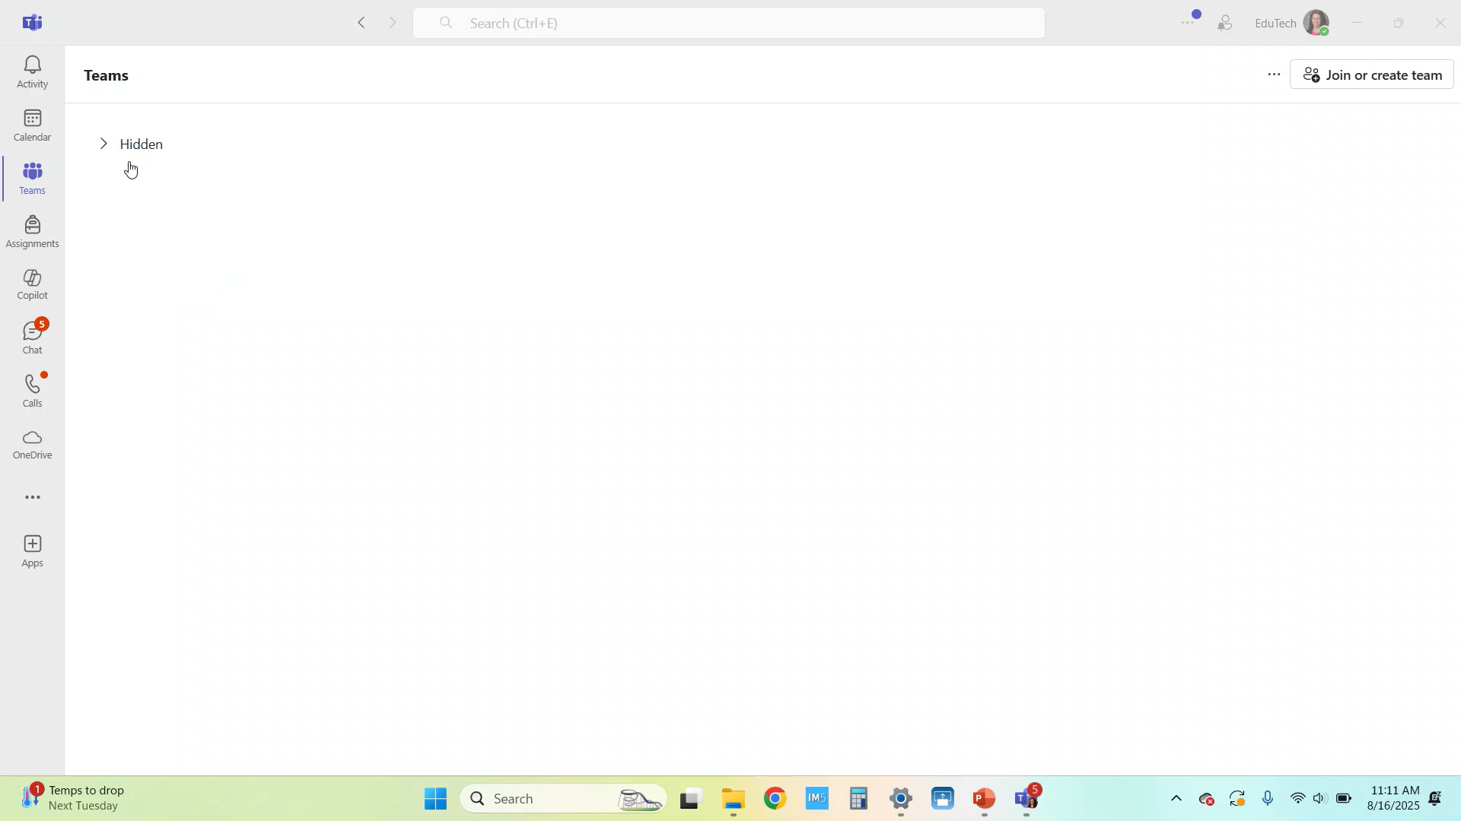

Slide 15
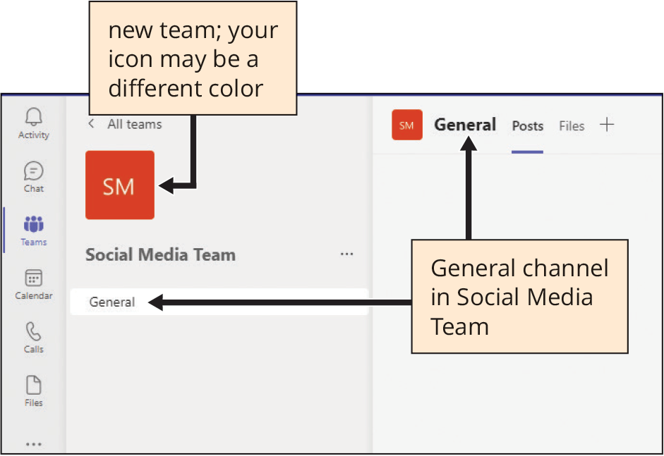
Working as a Team
By default, the General channel is created for you when you create any team
The purpose of this channel is to share an overview of what the team wants to achieve

Slide 16
Working as a Team
Role | Description
Owner | Team owners create the team and manage certain settings for the team. They add and remove members, add guests, change team settings, and handle administrative tasks. A team can have more than one owner.
Member | Members are the people in the team from your own organization. They talk with other team members in conversations. They can view, upload, and edit files.
Guest | Guests are people from outside your organization that a team owner invites to join, such as partners or consultants. Guests have fewer capabilities than team members or team owners, but they can still do most tasks within Teams.
Notes:
A team consists of three roles, and each role has a different level of permissions for what it is allowed to do within the team.

Slide 17
Starting the Conversation in Teams
After inviting someone to your team, it’s time to start the conversation.
Microsoft Teams allows team members and guests to communicate in real time using the chat feature.

Slide 18
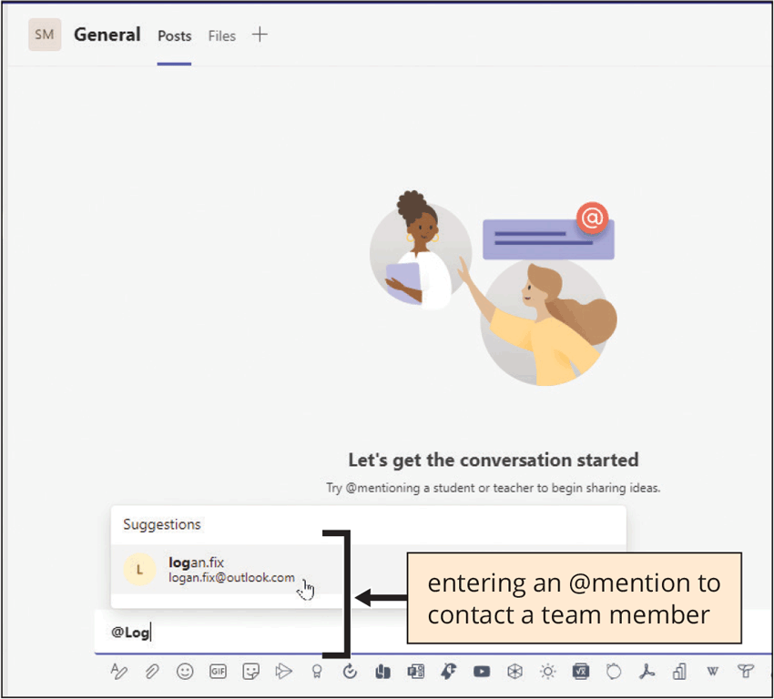
Starting the Conversation in Teams
You should use an @mention in a channel post every time you want to alert a team member or guest to a message
You can even get the attention of the whole group by using an @mention to notify the entire team

Slide 19
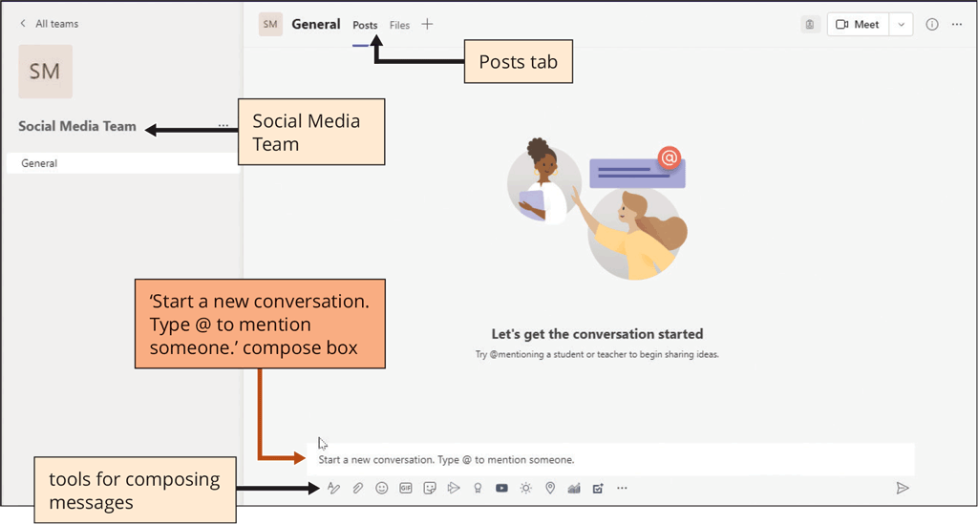
Starting the Conversation in Teams
To Post Messages to Your Team
  Click the New conversation button on the Posts tab
  Type @ and the first few letters of your team member's email address in the Start a new conversation box
  Click the email address below Suggestions to accept your team member’s email address
  Type the message and press ENTER
Notes:
When you first create a team, the General channel is displayed and Posts is the first tab you see within the channel. Think of Posts as one large group threaded discussion with text, emojis, files, stickers, YouTube videos, prerecorded videos, and more.

Slide 20
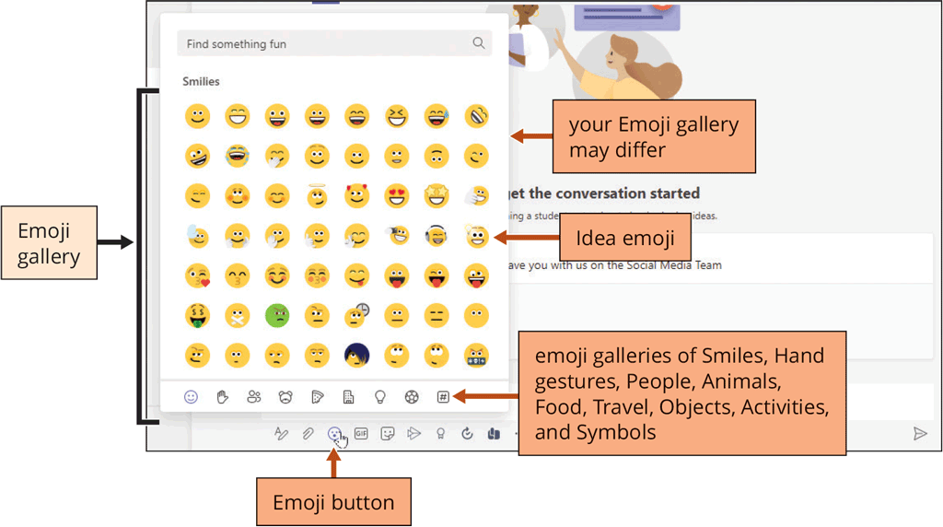
Starting the Conversation in Teams
While you are entering a message, you can click the Emoji button to select and insert an emoji
Notes:
Microsoft Teams is a complex communication and collaboration tool, but it still has features that you find in most messaging apps, such as emojis, GIFs (animated clips), and stickers. An emoji can help you accurately articulate your words both personally and professionally.

Slide 21
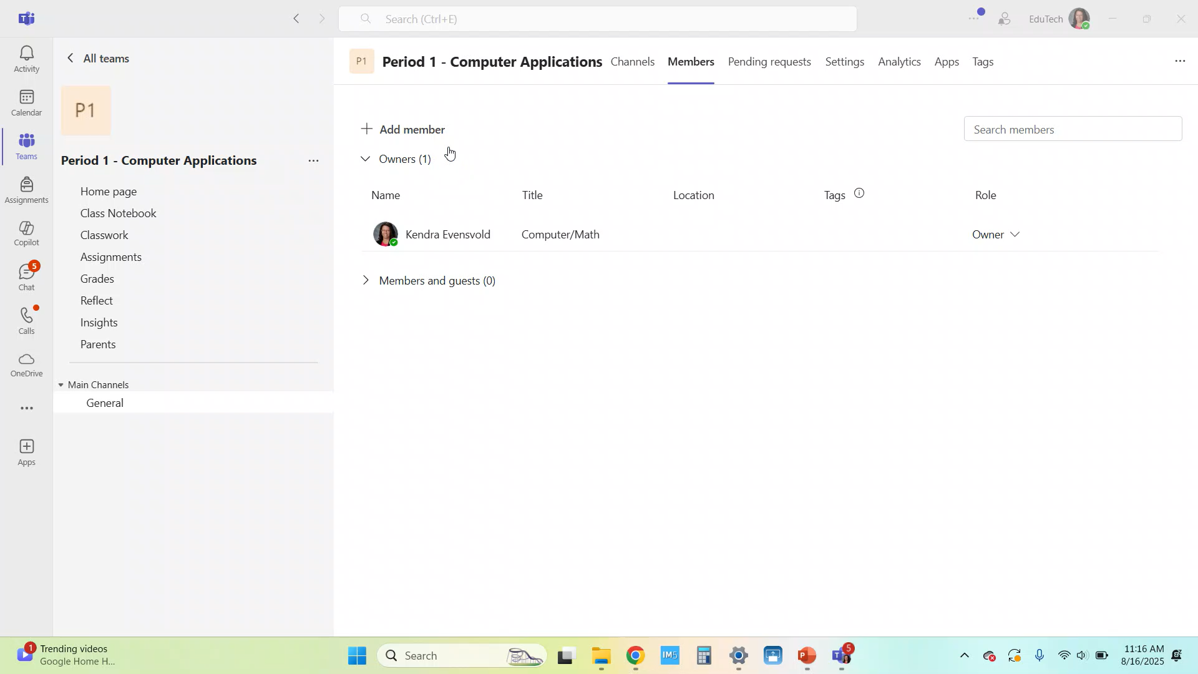

Slide 22
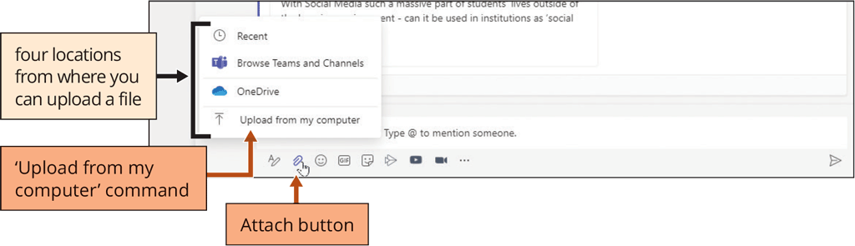
Uploading Files into a Team
To Upload a File Within a Team
  Click the New conversation button
  Click the Attach button
  Click a file location
  Locate and click the file to select it
  If necessary, click the Open button
Notes:
Microsoft Teams is a great platform for communicating with colleagues in real time and sharing files without needing to stop and open an email message to attach a file. You can upload, share, and collaborate with files.

Slide 23
Uploading Files into a Team
Team members can edit the same file within Teams by collaborating within Microsoft Word, Excel, or PowerPoint files.
Your changes will be seamlessly merged as you all work simultaneously.
When two or more people collaborate on a document, it is called coauthoring.

Slide 24
Uploading Files into a Team
A lot of work is accomplished in a team’s discussion
The added benefit to keeping the conversation going as you complete a project is that you have one central location in which to record the correspondence
By using a search term to filter a discussion, you can quickly navigate to the exact topic in your chat log history

Slide 25
Making a Voice Call from Teams
Teams can act as a basic phone with features such as:
  Call answering and initiating (by name and number) with integrated dial pad
  Call holding and retrieving
  Call forwarding and simultaneous ringing
  Call history
  Voicemail

