Slide 1
Unit 1 Foundations & Threats
Section 5 – Malicious Code

Slide 2
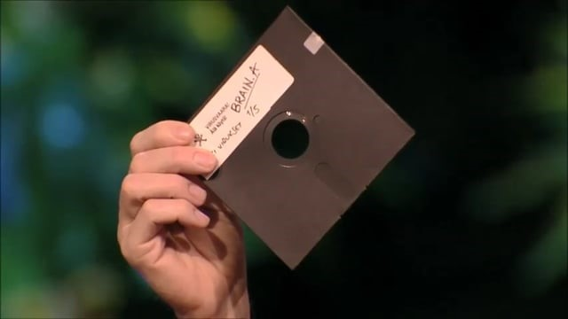

Let’s Go Back To The Very Beginning
What was the very FIRST piece of malware?
Notes:
The very first piece of malware is widely considered to be Creeper, created in 1971.
Created by: Bob Thomas at BBN
Platform: ARPANET (the precursor to the modern Internet)
What it did:
Creeper was an experimental self-replicating program that moved between computers and displayed the message:
“I’m the creeper, catch me if you can!”
Intent:
It was not malicious by today’s standards—it didn’t damage systems or steal data. It was more of a proof of concept showing that a program could spread across a network.
Fun follow-up fact
The first antivirus program was created shortly after:
Reaper (1971) was designed specifically to find and remove Creeper, making it the first known anti-malware tool.

Slide 3

VIRUS
Virus = a program that attaches to a host file with the goal of installing itself on a system.
  A virus is added to an executable file so that when that app runs, the virus installation is activated.
  When a virus runs it performs some action that is either malicious or simply annoying.
Notes:
A virus is a type of malware that cannot run on its own. It must attach itself to a legitimate program or file, which is called the host file. The goal of a virus is to secretly install itself on a system and then spread when that infected file is shared or executed.
Most viruses are attached to executable files, such as .exe files. When a user opens or runs the program—often thinking it is safe—the virus is activated at the same time. This is why viruses often spread through things like email attachments, downloaded software, USB drives, or pirated programs.
Once the virus runs, it can perform a variety of actions. Some viruses are malicious, meaning they are designed to cause harm—such as deleting files, corrupting data, stealing information, or disabling system functions. Other viruses are more annoying than destructive, displaying pop-up messages, slowing down the computer, or changing system settings.
An important thing to note is that viruses typically require user action to spread. Unlike worms, which can spread automatically across networks, viruses usually rely on someone opening a file or running a program. This is why safe downloading habits, email awareness, and antivirus software are critical for prevention.

Slide 4
WORM
Worm = program that reproduces itself and can transport from system to system without attaching to a file.
  A worm resides in active memory and keeps replicating itself.
  When a worm replicates enough to consume massive system resources, the device operating system will slow down or even crash.
What’s the difference between virus & worm?
The difference is that a virus needs another program or host to replicate, a worm can do it on its own.
Notes:
Make sure the students understand that “replicates” = the ability to modify programs to include a version of the original virus.
KEY POINT: Difference is that a virus needs another program or host to replicate, a worm can do it on its own.
In real life, there are very few actual viruses that need a host file anymore, it is mostly worms and trojans out there. But it is important to use the terminology properly. As the student presentations cover the evolution of malware, it becomes more obvious how we transitioned from viruses to worms.

Slide 5

WannaCry:
In 2017 the WannaCry ransomware hit over 200,000 computers in 150 countries in just one day.
Here’s the story of how it was stopped . . .
Notes:
In 2017, the WannaCry ransomware attack spread at an unprecedented speed, infecting over 200,000 computers across more than 150 countries in a single day. This made it one of the fastest and most widespread cyberattacks in history.
WannaCry exploited a vulnerability in Microsoft Windows using an attack method known as EternalBlue, which targeted systems that had not installed recent security updates. Because many organizations delayed updates, the malware was able to spread rapidly through networks without any user interaction.
Once a computer was infected, WannaCry encrypted the victim’s files, making them inaccessible. The malware then displayed a message demanding a Bitcoin ransom in exchange for a decryption key. Victims were given a limited amount of time to pay, with threats that files would be permanently lost if the deadline passed.
The attack had serious real-world consequences. Hospitals, transportation systems, businesses, and government agencies were affected. In some cases, hospitals were forced to cancel surgeries and divert patients because staff could not access medical records or systems.
WannaCry highlighted the critical importance of patch management, regular system updates, and cybersecurity awareness. Even though Microsoft had released a patch before the attack, many systems remained vulnerable because the update was never installed.
Note that in many malware stories we don’t have all the details. In some cases we know who created it, in others we may only know what damage was done and in the case of WannaCry, we know who was able to stop it. Each iconic malware has an interesting story that shows how it played an important part in what cybersecurity practices were developed in response to those threats.

Slide 6
TROJAN
Definition: files that appear to be legitimate programs, but really contain malicious code.
Usually, will do that one nice thing – play a game, or song, etc. AND it has hidden program.
The main difference between a Trojan and a virus/worm is that a Trojan does not replicate itself.
RAT = Remote Access Trojan
Definition: Trojan that installs a backdoor for administrative control over the victim PC.
Notes:
The legitimate program of a Trojan usually DOES work - you actually get to play that game or song or movie. That way the person who has the Trojan doesn’t suspect anything unless it’s poorly made. LOTS of Internet free games are actually Trojans for malware. You happily download the free software and install it on your device, it happily installs some extra malware code in the background.
The most dangerous type of Trojan is the RAT - Remote Access Trojan, which is essentially a backdoor packed inside a Trojan. The Trojan delivers code onto your machine that makes it possible for the hacker to remotely access your system and try to control it.

Slide 7
BACKDOOR
Definition: programs that create a mechanism for gaining access to a computer.
  leave a port open
  create a bogus user with privileges
Usually delivered through a Trojan horse
  NetBus
  BackOrifice
  SubSeven
  T0rnkit
  examples of legitimate backdoors.
  examples of malicious backdoors
  VNC
  PC Anywhere
Notes:
A backdoor exists to provide a means of going in and out of a computer. Two popular methods to accomplish this are to leave a port open or to create a user with privileges.
The “payload” of a Trojan horse is often a backdoor.
Listed are a few well-known malicious backdoor programs BUT there are reasons why a legitimate user would want to be able to access their computer when they are away from home or the office. VNC = Virtual Network Computer and PC Anywhere are 2 popular legitimate programs to access your computer remotely. And they work by leaving a port open that can be accessed specifically by that program.

Slide 8
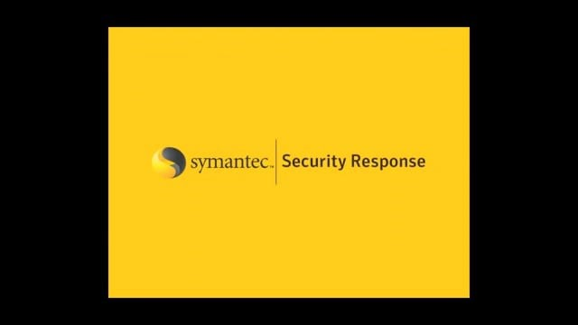
Demo of Backdoor.Ghostnet
Notes:
Video by Symantec Security Response = demonstrates one version of a backdoor in action = 4:36 min

Slide 9
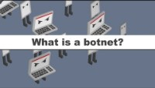
From Backdoors to BOTNETS
Trojans or other malware are used to
deliver a Backdoor program onto
your computer or IOT device.
The Backdoor program is used to
communicate back to the “Command
and Control server” - aka C2C server.
The C2C server sends your PC program code to perform an action such as sending out spam or stealing information or participating in a Distributed Denial of Service attack
Your device is now in a botnet - and it’s likely you don’t know it!
Notes:
So the sequence goes like this: virus, worm or trojan infects your computer - it puts a backdoor program on your computer - the backdoor activates and communicates with the botmaster - and your computer is now part of a botnet of other computers that can be multiplied into a very powerful mass attack.
Compromised computers, unknown to their innocent owners, are being used by hackers to send out large volumes of spam, launching distributed denial-of-service attacks, or stealing confidential information. Typically they are home users who are not properly protected with up-to date anti-virus software, firewalls and security patches.
Video= 3:09 https://www.youtube.com/watch?v=6V5BeXypd6U&t=86s&ab_channel=IDGTECHtalk

Slide 10
LOGIC BOMB
Definition: small program that is timed to perform an operation on a system.
It can also be triggered by an external event.
A programmer might install a logic bomb on a system, timing it to go off long after he or she has left the company.
Notes:
A logic bomb is a type of malicious code that is hidden inside a legitimate program and is designed to activate only when specific conditions are met. Unlike viruses or worms, a logic bomb does not spread on its own and may remain dormant for long periods of time.
The “logic” in a logic bomb refers to the trigger condition that causes it to execute. This trigger could be a specific date or time, the deletion of a user account, the absence of a particular file, or the execution of a certain action within a system.
Once triggered, a logic bomb can carry out a wide range of actions. These actions may be malicious, such as deleting files, corrupting databases, or shutting down systems. In some cases, the effect may be more subtle, such as slowing down processes or altering data in a way that is not immediately noticeable.
Logic bombs are often associated with insider threats, such as disgruntled employees or contractors who have authorized access to systems. Because the code is embedded in legitimate software and does nothing until triggered, logic bombs can be very difficult to detect using traditional antivirus tools.
This type of attack highlights the importance of code reviews, access control, monitoring system changes, and proper offboarding procedures when employees leave an organization.

Slide 11
ROOTKIT
Definition: a group of programs installed by an attacker
to gain complete control of a computer.
Changes how the operating system functions
Can hide its processes and actions so that it is not detected by antimalware or the user.
How to STOP IT - you don’t. It is too difficult to be sure all of the rootkit is removed. Solution is to wipe the hard drive and reinstall the Operating System and files.
Notes:
A rootkit is a type of malware designed to hide itself and other malicious software on a system. The name comes from the word “root,” which refers to the highest level of administrative access on a computer, and “kit,” meaning a collection of tools. Once installed, a rootkit allows an attacker to maintain unauthorized, privileged access while remaining difficult to detect.
Rootkits work by modifying the operating system or system-level processes so that malicious activity is concealed. This can include hiding files, processes, registry entries, or network connections from antivirus programs and system monitoring tools. Because of this, a system may appear to be functioning normally even while it is compromised.
Rootkits can be installed in several ways, including through infected software downloads, phishing emails, or as part of another malware attack. Some rootkits operate at the application level, while more advanced ones run at the kernel or firmware level, giving them deeper control over the system.
Once a rootkit is in place, attackers can use it to log keystrokes, steal data, install additional malware, or control the system remotely. Removing a rootkit is often difficult and may require specialized tools or even a complete operating system reinstallation.
Rootkits demonstrate why system updates, trusted software sources, least-privilege access, and strong endpoint protection are critical parts of cybersecurity defense.

Slide 12
Summary of Differences
Trojan - deliver backdoor to the victim system
Backdoor - allow access to the victim system
Rootkit - take over control of the victim system

Slide 13
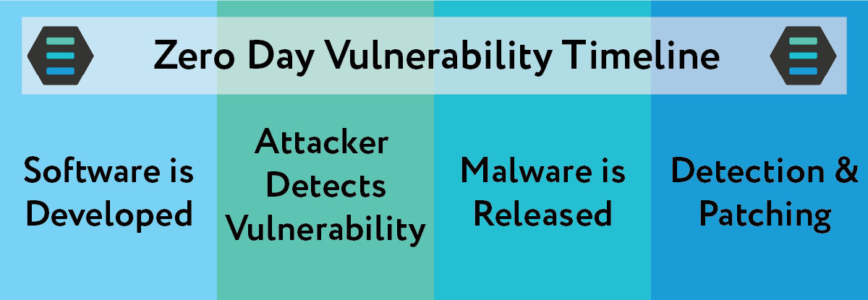
ZERO DAY
Zero Day – an attack that takes advantage of code flaws that have VERY recently been discovered.
Key to a Zero Day Attack is that there is a time period where the flaw is not known to exist so there are no defenses or signatures against it.
Vulnerability window = time between start of attacks and the time a solution is released. (Usually, a software or OS update!!)
Notes:
Zero Days are worth including here as they are part of the larger picture of system attacks. However, they are NOT actually malware - instead, a Zero Day is a flaw that exists in the code of an application or OS. Of courses, most programs have some sort of flaws, but the ones we care about are the areas in which the programmer made the code work but didn’t think through the security of the application. This means that there is a vulnerability and once that vulnerability is discovered it can be exploited.
NOTE: Zero Day exploits can be sold for a LOT of money depending on what type of application is vulnerable. ($1,000 to $100,000)
Timeline details.
Software is developed - software is developed but unbeknownst to the developers, it contains a security vulnerability.
Attacker detects vulnerability - a bad actor finds a vulnerability either before the developer or exploits it before a developer having an opportunity to release an update or patch.
Malware is released - attackers release malware to exploit software while the vulnerability is still open and unpatched.
Detection & Patching after hackers release the exploit, either the public detects identity or data theft or the developer uncovers, and creates a patch.

Slide 14
APT - Advanced Persistent Threat
Definition: an attack that uses sophisticated methods to establish a presence on a system or network for an extended period of time. Maintains multiple ways in and out, often used to exfiltrate data
Signs of an APT Attack
  Off-hours activity showing up in logs
  Large unknown files or strange data flows
  Multiple RATs found by security scans
  Spear-phishing emails
  Pass the hash tools
Tools for initial entry
Notes:
An Advanced Persistent Threat, or APT, is a long-term, targeted cyberattack in which an attacker gains unauthorized access to a system or network and remains undetected for an extended period of time. Unlike quick “smash-and-grab” attacks, APTs focus on persistence, stealth, and ongoing data access.
The word advanced refers to the attacker’s use of sophisticated techniques, such as custom malware, zero-day exploits, social engineering, and stolen credentials. Persistent means the attacker maintains access over weeks, months, or even years. Threat indicates that these attacks are often carried out by organized groups, sometimes linked to nation-states or well-funded criminal organizations.
APTs typically begin with reconnaissance and phishing to gain an initial foothold. Once inside, attackers move laterally across the network, escalating privileges and carefully avoiding detection. Their goal is often data theft, espionage, or long-term surveillance, rather than immediate destruction.
Because APTs operate quietly, victims may not realize they are compromised until sensitive data has already been stolen. Traditional antivirus tools alone are often not enough to detect these threats. Defending against APTs requires continuous monitoring, network segmentation, multi-factor authentication, and employee cybersecurity awareness.
APTs highlight the reality that cybersecurity is not just about preventing attacks, but also about detecting and responding to threats that may already be inside the system.

Slide 15
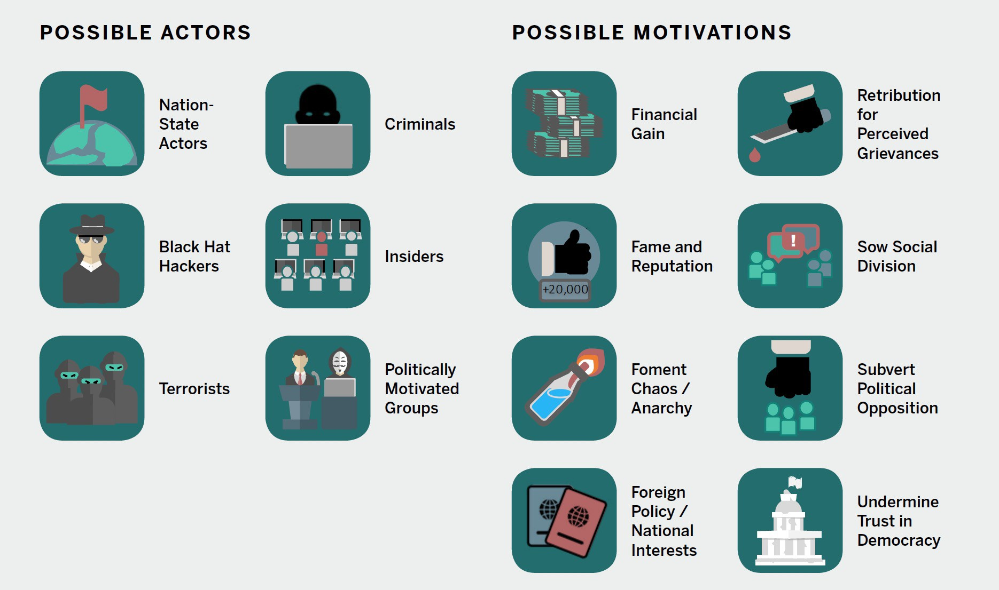
The Who and the Why of Cyber Threats
Source: https://www.belfercenter.org/sites/default/files/2018-02/cyberactorsmotivations.jpg
Notes:
At the beginning of this PPT we saw that the Brain virus was created so that the authors could prevent people from making illegal copies of their medical-monitoring software. It is important to consider that there are many different types of possible threat actors with a wide range of motivations for their actions. This slide shows many of those combinations. In the next activity, Historic Malware Project, students will investigate the actors and motivations behind some of the most impactful cyber threat events in cybersecurity history.

