Slide 1
5-3 Network Naming

Slide 2
Networking = Sharing Info
Humans typically communicate using 2 basic methods
  Speaking - in person, in a group, on the phone
  Writing - letter, email, text message, notes on the board
The typical methods have rules to make it work smoothly
  Speaking: Take turns, raise your hand, no yelling
  Writing: Addressing, salutation, punctuation.
Network communications have rules too
  Rules for finding devices on the network
  Rules for making connections
  Rules for each type of info being shared
Notes:
In this slide we are establishing that human beings have already developed methods for making sure that our communications are not chaos. That people are not screaming on top of each other to be heard because we have rules - for taking turns, for specifying who we are talking to, etc.
So since we have spoken and written rules of communication, it seems like a good idea for our network communications to get on the rules bandwagon. And in fact, the types of rules are very similar.

Slide 3
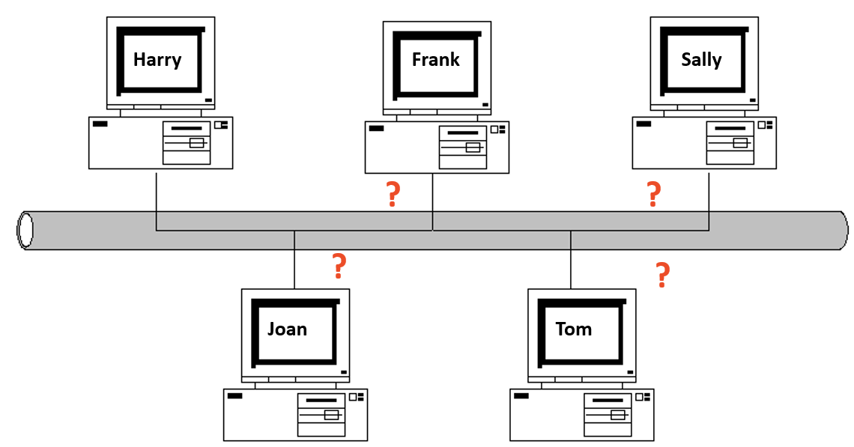
Finding Devices in a Network
Harry wants to send a message to Sally, but they are not the only users of the cable.
What are the chances Harry’s message will actually get to Sally?
Notes:
The slide animation of a packet delivery will happen automatically
The first job in networking is to find the device I want to communicate with. In a crowded room, how would I find Sally? Just yell her name? What if there are 5 Sallys in the room? How will I know my yelled message is getting to the right Sally? The same thing is true in a network, except maybe worse - because we can’t actually deliver data based on the name of the user sitting at the computer. We need a very specific way of addressing so that no delivery mistakes are made.

Slide 4
Finding Devices in a Network - MAC Address
Rule #1 – your device must be unique
There must be an addressing system, a way of uniquely identifying computer interfaces.
An “interface” on a device is a component that acts as a door for connections.
A NIC is a Network Interface Card
Every NIC has a hardcoded MAC address assigned by the manufacturer.
Devices can have more than one NIC BUT each one must have a unique MAC address.
Notes:
The first rule is everyone MUST have a unique name. There may be a lot of Sallys in the world, but our networked devices can’t have duplicate identifiers.
The term “interface” is used a lot in technology and the definition should be clearly understood. The NIC is the interface that is given the unique MAC address.

Slide 5
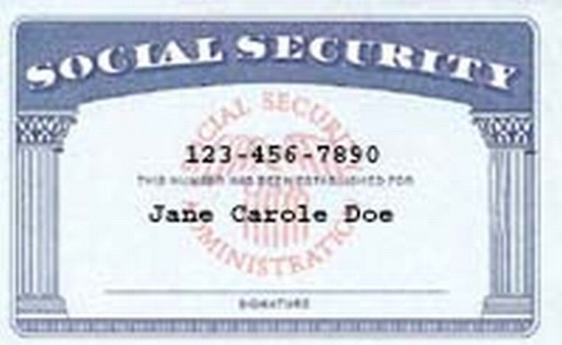
MAC Address
Media Access Control Address = unique identifier for each networking device
Also known as the physical address of a device
Represented as 12 hexadecimal digits
00:24:E8:83:68:96 OR 00-C0-CA-52-38-8C
A MAC address is like a SS #
- not changeable, unique to you
Notes:
MAC addresses are hard for humans to remember and organize. Sort of like trying to find a person by using their fingerprint.

Slide 6
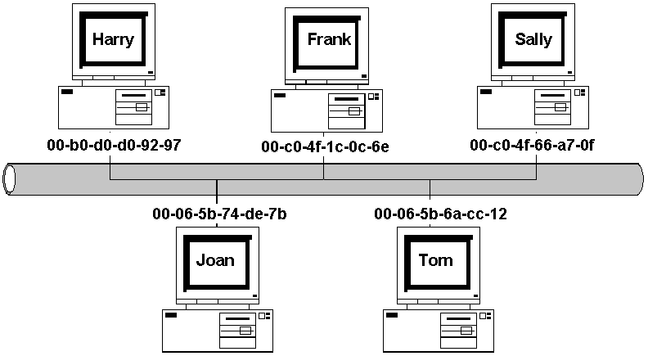
Finding Devices In A Network: Mac Addresses
With MAC addresses, we can uniquely identify each device or interface on the network.
Alert – Mac Address can be spoofed!
Notes:
Since these MAC addresses are unique in the whole world (or they are supposed to be) - that means that devices can communicate reliably across large networks.
CLICK to bring up alert about spoofing:
Mac address spoofing is often used to bypass WiFi security features

Slide 7
Finding Devices in a Network - IP Address
Rule #2 – you must “belong” to a network
Joining a network provides you with lots of cool stuff:
  Access to shared files
  Access to devices like printers or scanners
  Access to Internet Service Providers
When you join a network, you become connected
Great! How do I join?! Get an IP Address!
Notes:
We actually use a second address in networking, not just the MAC address. While MAC addresses are unique, the hexadecimal numbers are difficult for humans to work with. Plus, since they are burned into the ROM, we can’t manipulate them to help with organizing. MAC addresses are a lot like fingerprints - they are unique, but not exactly a way to look someone up to say hi.

Slide 8
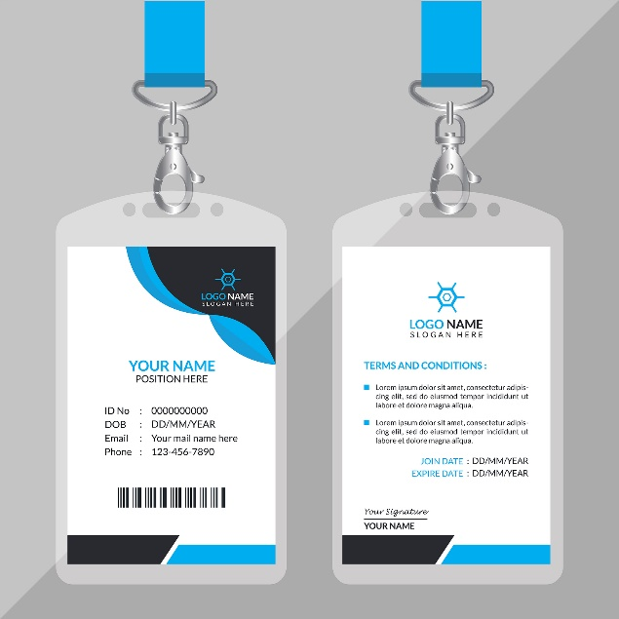
IP Address
Internet Protocol Address
= TEMPORARY identifier for each interface
Must be unique among the connected devices on that network
Also known as the logical address of a device
An IP address is like an ID card
  Changeable
  Can belong to many organizations
  Unique within that organization
Notes:
Networks added the IP address. It is similar to a phone number - easy to remember, to write down and look up. PLUS you can change your IP address based on what network you are in.
EMPHASIZE that an IP address still must be within your local area network. So if I am at school, my laptop gets an IP address that is unique from all the other PCs on the school network. But then when I go to Paneras and sit down to work, my laptop gets a new IP address that is unique from all the ones at Paneras.
Ask students how many knew about IP addresses? How many knew about MAC addresses? Usually fewer people know about MAC addresses but network communications don’t work without them. You need both to get your data across a network.

Slide 9
IP Address cont’d
There are two types of IP addresses, IPv4 and IPv6.
IPv4 –the old kind, but it is still the most commonly used.
IPv6 - newer but not yet widely used. (will look at this in future units)
The IPV4 format is four decimal numbers separated by dots. (Dotted decimal notation).
Each section is called an octet and can hold a decimal number from 0 to 255.
Example: 192.168.55.32
Notes:
The IPv4 octet gets its name because it holds 8 bits. If each bit is turned on then that binary number (11111111) will equal 255. We will take a closer look at IP addressing in a future lesson.

Slide 10
Find a Device = ARP
Important network rule: the sending device must know BOTH the IP and the MAC address of the receiving device.
ARP (Address Resolution Protocol) is a tool used by devices on the same network to find the MAC address associated with an IP address
One device broadcasts an ARP request to all the devices on the network. It’s sort of like yelling to see if you can find someone.
The device with the IP address responds with its MAC address. Let’s see an example:
Notes:
Address Resolution Protocol is a foundation of network communications. It is exactly like someone yelling in a room, so if a network has a lot of ARP broadcasts going out then that network is probably going slow. Just like when highways slow down when they have too much volume, the same is true of networks.

Slide 11
How ARP Works
I am!!!
A1:FF:32:5A:EC:AA
Bob
Hey, everybody
Who is
10.0.0.1?
10.0.0.3
C0:43:1E:00:57:D3
Sally
Ok – I’ll put that in my ARP table
Internet address | Physical address
10.0.0.1 | A1:FF:32:5A:EC:AA
10.0.0.1
Notes:
Click for animation of slide: Bob wants to send a message to a computer whose IP address is 10.0.0.1 BUT he needs the MAC address for that device. Remember, a device can’t send packets to a specific device unless we have both the IP and the MAC address.
So Bob sends out an ARP broadcast - a message that goes to every connected computer asking “who is 10.0.0.1?” .Sally’s computer responds by providing her MAC address. Bob puts that information in his ARP table so that any further packets for Sally can go right out without the need for more ARP broadcasts.
NOTE that the ARP table doesn’t last forever - because devices don’t keep their IP Addresses forever.

